Slide 1
ITSC 206: Advanced Networking for Offensive and Defensive Environments
Lecture 1: Fundamentals of Network Security
Notes:
PLEASE READ SLIDE NOTES

Slide 2
Table of Contents
Intro
Course Grading
Communication / Attendance
Network Review
Network Security
Threats
Defenses (Defense in Depth)
Wired vs Wireless Networks
Network Vulnerabilities
Security Toolbox

Slide 3
Intro
Instructor – Viktor Lyagutsky
Background
Class
Each student

Slide 4
Course Grading
Labs x 8
Quiz x 7
Mid Term Exam
Final Exam
15 %
10 %
35 %
40 %

Slide 5
Communication / Attendance
Instructor to Student
Email
Pre and post class (15 min)
During lecture / lab
Student to Instructor
Email pre and post class
Schedule appointment
Class/Lab/Quiz/Exam Attendance
Flexibility but communication is key

Slide 6
Network Review

Slide 7
What is a Network
A network is an interconnection of three or more communicating entities
A number of nodes connected by some sort of communications path
This can include but not limited to Ring, Dual Ring, Tree, Mesh, Bus, Star

Slide 8
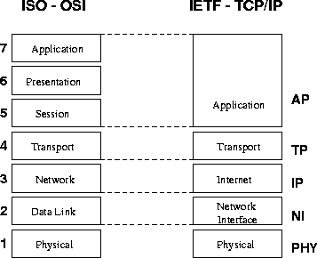
OSI / TCP Layers

Slide 9
IP Addresses v.4
Resides at the network layer, it must be capable of providing coms between hosts on different kinds networks (datalink or physical implementations)
Are usually shown in dotted decimal notation of 32 bits eg 1.2.3.4
00000001 00000010 00000011 000000100
The IP consists of the Network ID and Host ID that are used for routing through ASN’s (Autonomous System Number).

Slide 10
Internet Address Classes
Class A
128 possible network Ids
over 4 million host Ids per network
Class B
16k possible network ids
64k possible host ids per network
Class C
over 2 million possible network ids
about 256 hosts ids per network
Class D is used for multicasting
Class E is used for experimentation

Slide 11
Subnetting
An organization can subdivide it’s host address space into groups called subnets.
The subnet ID is generally used to group hosts based on the physical network topology.
Can simplify routing and security
create a dynamic network

Slide 12
Network Address Translation
Internal hosts can be assigned various internal (non-routeable) addresses eg
Range 1: Class A - 10.0.0.0 through 10.255.255.255 /8
Range 2: Class B - 172.16.0.0 through 172.31.255.255 / 12
Range 3: Class C - 192.168.0.0 through 192.168.255.255 /16
see RFC 1631
Increased the life span of IP v4
can be used for load balancing
can be used for back up links (multihomed)

Slide 13
IP V4 vs V6

Slide 14
TCP/IP Summary
IP: Network layer protocol
unreliable datagram delivery between hosts
UDP: Transport layer protocol
unreliable datagram delivery between processes
TCP: Transport layer protocol
reliable, byte-stream delivery between processes
https://en.wikipedia.org/wiki/Network_security
Notes:
Having said that, it means not only computer information, but all kinds of information like coded letters

Slide 15
Common Network Services
SMTP, POP
Telnet
FTP, TFTP
DNS
Gopher
http
NFS
NIS
X Windows
Rlogin
wms & rtsp
RDP
ssh
etc

Slide 16


Architecture Review
10.1.1.1/192.168.123.1
Remote
Access
10.1.1.2
Internet
10.1.2.1/192.168.123.2
10.1.2.2
10.1.3.1/192.168.123.3
192.168.123.0/24
10.1.3.2
10.1.4.1/192.168.123.4
InternalServers
10.1.4.2

Slide 17
Network Security

Slide 18
What is Network Security?
“Network security consists of the policies and practices adopted to prevent and monitor unauthorized access, misuse, modification, or denial of a computer network and network-accessible resources. Network security involves the authorization of access to data in a network, which is controlled by the network administrator. Users choose or are assigned an ID and password or other authenticating information that allows them access to information and programs within their authority.”
https://en.wikipedia.org/wiki/Network_security
Notes:
Having said that, it means not only computer information, but all kinds of information like coded letters

Slide 19
Network Security Goals
Confidentiality
Guarantees network data is transmitted in a confidential manner
Integrity
Guarantees network data is transmitted in the original representation, unchanged
Availability
Guarantees network data is accessible when it is requested

Slide 20
Confidentiality
Protection against sensitive information from unauthorized disclosure or intelligible interception by unauthorized entities.
Cryptography and access control are used to protect confidentiality;
Encryption call be applied to any layer in the OSI stack, commonly done at the network layer;
There are three forms of access control;
Administrative
Physical
Logical

Slide 21
cont - Confidentiality
Access control is the process of limiting the privileged use of system resources;
Administrative controls based on policies which state the objectives regarding controls over access to resources, hiring and management of personnel, and security awareness;
Physical controls by limiting access to anywhere that contain restricted assets of network nodes and wiring;
Logical controls are the hardware and software means of limiting access which includes access control lists, communication protocols, file system permissions and cryptography

Slide 22
Data Integrity
Ensure that software or information is complete, accurate and authentic
network integrity is when the message is received complete and unmodified between valid source and destination;
Message Authentication Codes, Hash function
Connection integrity can be accomplished by using cryptography and routing control;
Encryption
Vetting, templates
Trace Files, Logs (for recovery)

Slide 23
System Integrity
Configuration Management
Perimeter Defense
Intrusion Monitoring (IDS, A/V)
Trusted Distribution
Policies (AUP, S/W Control, Info Handling)
Personnel Security
Physical Security
Access Control

Slide 24
Availability
Ensure that resources (including information) are available and functional.
Using systems that are designed with
redundancy,
fault tolerance (failover),
Reliability (resilience),
backups & recovery, and
load balancing
End users view availability as being the entire system - applications, servers & network
Since 2000, large web sites Yahoo!, eBay, Amazon, CNN etc the focus of attack for hours/days with Distributed Denial of Service Attack

Slide 25
Network Security Controls
Include network access controls to enforce access policies (e.g., NAC, firewalls, IDPS, web and email content security)
Authentication (e.g., login credential, multi-factor authentication)
Encryption technology secures communications between hosts or networks

Slide 26
Info vs OT Security Triad
Information
Technology
Operational
Technology
Integrity
Confidentiality
VS
Integrity
Confidentiality
Reliability
Resilience
Availability
Availability

Slide 27
Discussion

Slide 28
Defense in Depth

Slide 29
Defense in Depth
Defense in Depth is a concept borrowed from military
The idea is simple:
Use multiple layers of defense to delay an incoming attack by yielding space to buy time
Because attackers must work through different defense layers to access internal resources, the attack has higher chance of being detected, giving the organization time to respond
In network security, defense in depth includes multiple layers of firewalls, DMZ, IDS/IPS, antivirus, web filtering, etc.

Slide 30
Defense In Depth
Like an Onion (a layered approach)
Each layer using different technologies or management controls
Perimeter of Network
Internal Network
Human Factor
30

Slide 31
Defense In Depth
The Perimeter – No Maginot Line
“Do not strike at strength … attack that which is weak…” - Sun Tzu
Routers
Firewalls
IDS’s
VPN Devices
Software
OS, App, DB
DMZ’s and subnets
Perimeter
Defenses
31

Slide 32
Defense In Depth
Internal Network – The inner network safeguards
IDPS, Personal Firewalls
A/V Software
Software Hardening
OS patches etc
Only needed
Services running
Configuration Mgmt
Audits
Internal
Defenses
32

Slide 33
Defense In Depth
Human Factor – The people connected to our systems
Policies, Standards & Procedures
A/V Policy, AUP
Standards of Employee Conduct
BCP Procedures
Awareness Program
Sign AUP Annually
Security tip of the week
Advertise Best Practices
Human
Defenses
33

Slide 34
Discussion

Slide 35
Network Security Threats

Slide 36
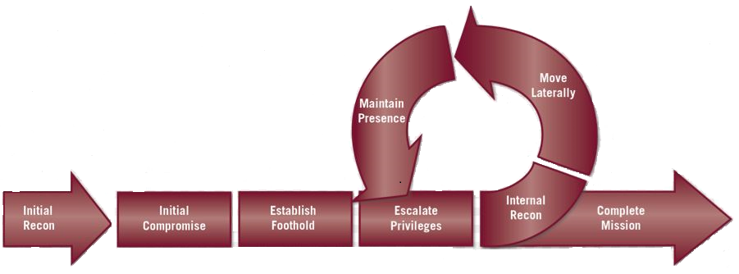
Threats – Enhanced Cyber Kill Chain

Slide 37
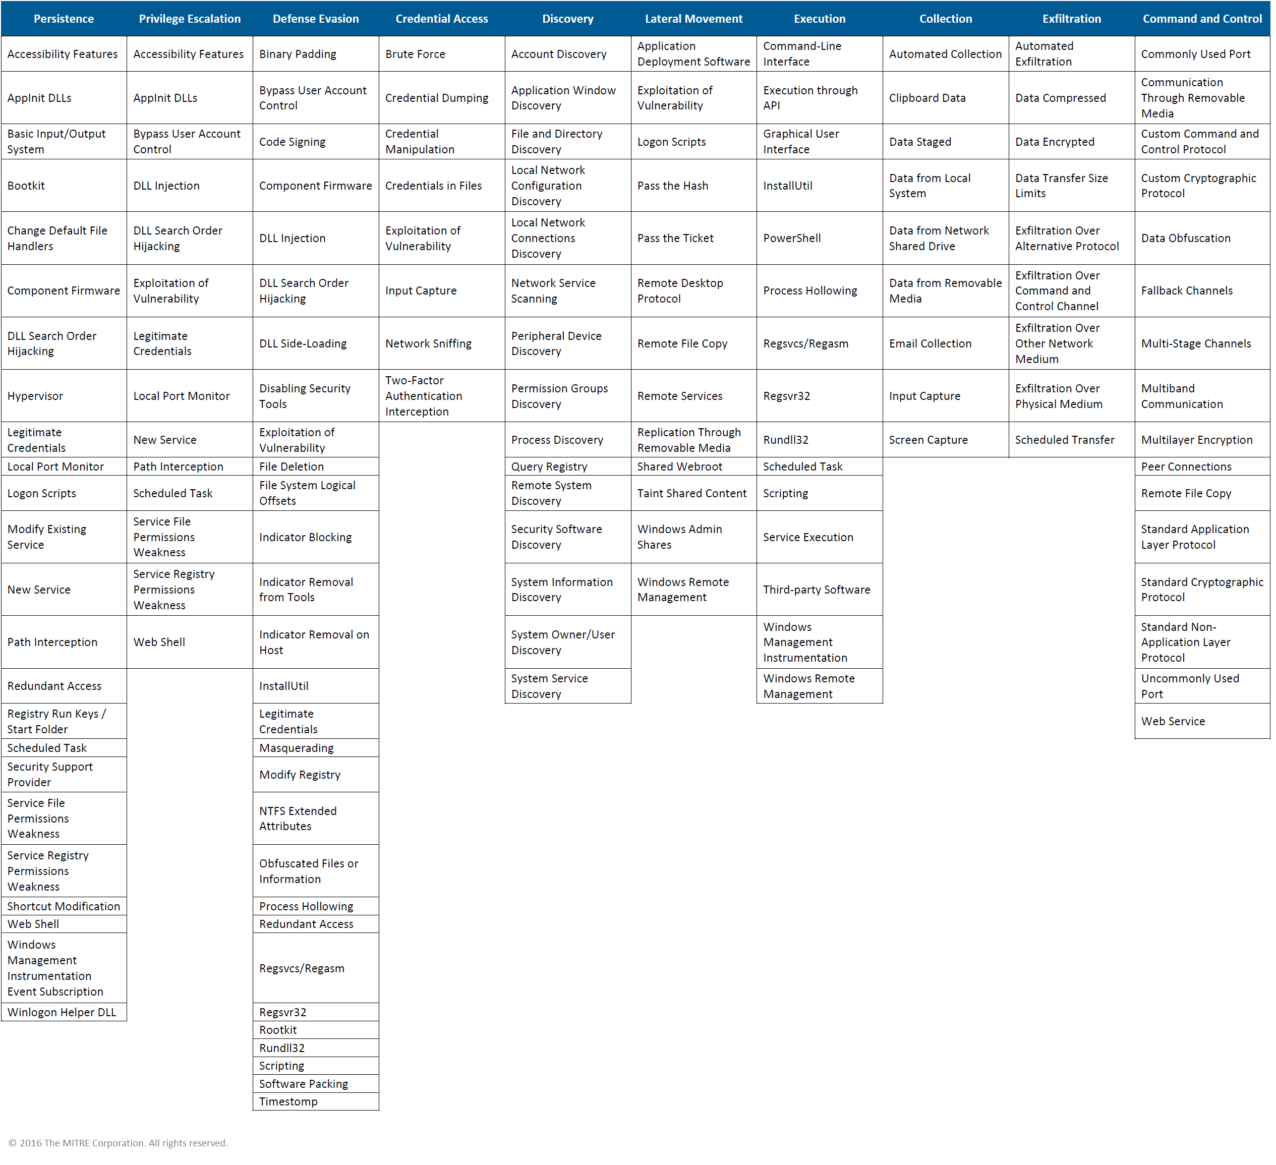
Threats – Mitre ATT&CK Matrix

Slide 38
Common Network Security Attacks
Network Attack
Wiretapping (sniffing)
Port scanners (IP, port etc)
Idle scans
DoS attacks
MAC, IP, DNS, DHCP spoofing
Man-in-the-middle attacks
ARP, DHCP poisoning
VLAN hopping
Smurf attacks

Slide 39
Common Network Security Attacks
Network & OS Attack
Buffer overflows
Heap overflows
Format string attacks
App attacks
SQL injections
Cross-site scripting
CSRF
Phishing

Slide 40
Discussion

Slide 41
Measures of Network Security

Slide 42
Network Security Defenses
Network segmentation / Firewalls
Network & OS Access controls
Behavioral analytics (Network / End Point)
Intrusion Detection System (IDS)
Intrusion Prevention Systems (IPS)
Data loss prevention (DLP)
Antivirus and antimalware (Network / End Point)
Email / Web security

Slide 43
Network Security Defenses
Security information and event management
Virtual Private Network (Net to Net, EP to Net)
Application security
Wireless security
Mobile device security

Slide 44
Discussion

Slide 45
Wired vs. Wireless Networks

Slide 46
Wired Network
Faster speed – up to 40 Gbps
Full duplex, collision free
Harder to sniff traffic
More reliable transmission
Requires physical connectivity, restricts mobility
More secure in general

Slide 47
Wireless Network
Slower speed – up to 2.3 Gbps (theoretically)
Shared medium, prone to collision
Easy to sniff traffic
Prone to transmission errors
Does not require physical connectivity
Less secure in general

Slide 48
Discussion

Slide 49
Network Vulnerabilities

Slide 50
Vulnerability Sources
Vendors
Networks
Avaya, Cisco, F5, Fortinet, Juniper, HP, Palo Alto, etc
OS
IBM, Linux, Microsoft, Oracle
Apps
US-CERT - www.us-cert.gov
CVE Mitre - cve.mitre.org

Slide 51
Identify Network Security Vulnerabilities
Research common network attacks
Perform an inventory of your network devices
Look up vulnerabilities associated with your devices
Employ vulnerability assessment tools
Assess the risks on all your devices

Slide 52
Internal Network Vulnerabilities
Network Perimeter – A line of defense established between the network you manage (your corporate network) and the outside network (the Internet)
Internal network vulnerabilities can be exploited from within the network perimeter
Vulnerabilities on workstations, servers, network devices, storage components, infrastructure nodes, etc.

Slide 53
External Network Vulnerabilities
External network vulnerabilities can be exploited from outside the network perimeter
Vulnerabilities on Internet-facing web servers, services, database, VPNs, firewalls, etc.

Slide 54
Discussion

Slide 55
Security Toolbox

Slide 56
Testing Frameworks
OWASP – Open Web Application Security Project
https://www.owasp.org
PTES – Penetration Testing Execution Standard
http://www.pentest-standard.org
OSSTMM – Open Source Security Testing Methodology Model
http://www.isecom.org/research/osstmm.html

Slide 57
Security Toolbox: Kali
Kali(BackTrack)
https://www.kali.org
Kali used as an offensive security tool to perform penetration testing
Standard tool for security analysts
This course uses Kali to perform most of the offensive network attacks
Download and install Kali into a VM environment
Samurai Security Testing Framework
http://www.samuraistfu.org/
PTF – Penetration Testers Framework
https://github.com/trustedsec/ptf

Slide 58
Kali Demo

Slide 59
Next Lecture
Read
Quiz?
Exam?

Slide 60
© 2017, Southern Alberta Institute of Technology. All rights reserved.
This publication and materials herein are protected by applicable intellectual property laws. Unauthorized reproduction and distribution of this publication in whole or part is prohibited.
For more information, contact:
Director, Centre for Instructional Technology and Development
Southern Alberta Institute of Technology
1301 16 Ave. N.W., Calgary, AB T2M 0L4

Slide 61
ITSC 206: LAN Networking for Offensive and Defensive Environments
Lecture 2: Secure the Local Area Network. (LAN)

Slide 62
Table of Contents
Review Lecture & Lab
MAC Address Spoofing
ARP Address Spoofing
VLAN Hopping
DHCP Starvation
DHCP Server Spoofing
IP Spoofing
STP Spoofing
Private VLan

Slide 63
Review Lecture & Lab

Slide 64
Review
Network Security
Threats
Defenses (Defense in Depth)
Wired vs Wireless Networks
Network Vulnerabilities
Security Toolbox
Lab: Architecture Review, Packet Investigation & Vulnerability Analysis

Slide 65
Threats, Vulnerabilities, Safeguards & Assets
Assets
Threat
Data
Facilities
Hw/Sw
Safeguards
Threat
Vulnerability
Threat
Safeguards

Slide 66
MAC Address Spoofing

Slide 67
MAC Address Spoofing
Very simple network attack technique
Attacking device can spoof a MAC address, registering itself as a different network node on the switch
This network attack technique serves as the basis for many higher-level network attacks
Including CAM overflow, ARP spoofing, DHCP starvation and DHCP server spoofing

Slide 68
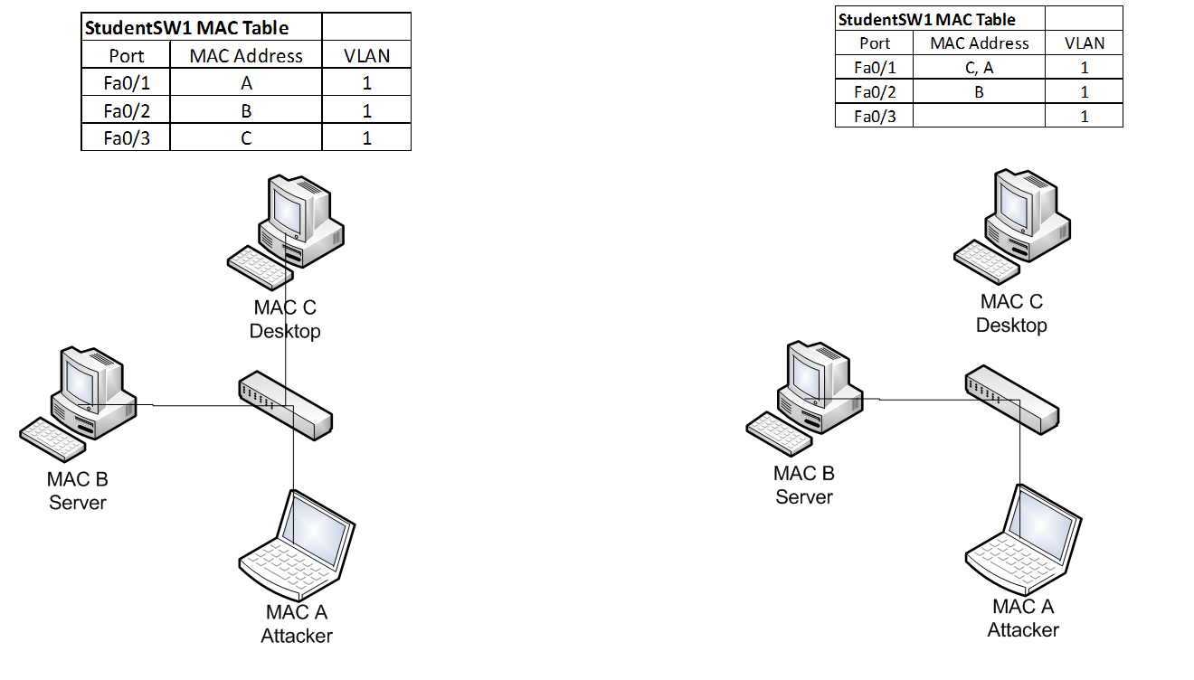
MAC Address Spoofing

Slide 69
MAC Address Spoofing Prevention
To mitigate MAC address spoofing:
Configure Port security on all access ports to limit the number of allowed MAC address registrations
Configure the violation types and the aging timers
Switch(config)# int range fa0/1-24
Switch(config-if-range)# switchport mode access
Switch(config-if-range)# switchport nonegotiate
Switch# show interfaces truck
Switch(config-if)# switchport port-security
Switch(config-if)# switchport port-security maximum 3
Switch(config-if)# switchport port-security mac-address sticky
Switch(config-if)# switchport port-security mac-address 0016.cb96.9594
Switch# switchport port-security violation {shutdown | restrict | protect}
Switch(config)#vlan 666
Switch(config)# int range fa0/2-24
Switch(config-if-range)# switchport access vlan 666

Slide 70
Discussion

Slide 71
ARP Spoofing

Slide 72
ARP Spoofing
Network attack designed to take over traffic for the targeted IP address (man-in-the-middle)
Relies on ARP protocol to associate the attacker’s MAC address to an IP address on the same LAN segment
Successful execution allows attacker to hijack network traffic for the targeted IP address
Particularly useful for spoofing a network gateway

Slide 73
ARP Spoofing
ARP spoofing builds on MAC address spoofing
Can be achived by sending specially crafted G-ARP packets to announce the MAC address for the target IP address on a particular network port
By repeatedly sending G-ARP packets, the MAC address is repeatedly associated with the attacker’s network port in the CAM table
Also, other hosts on the network intercept and store the attacker’s MAC address for the target IP address

Slide 74
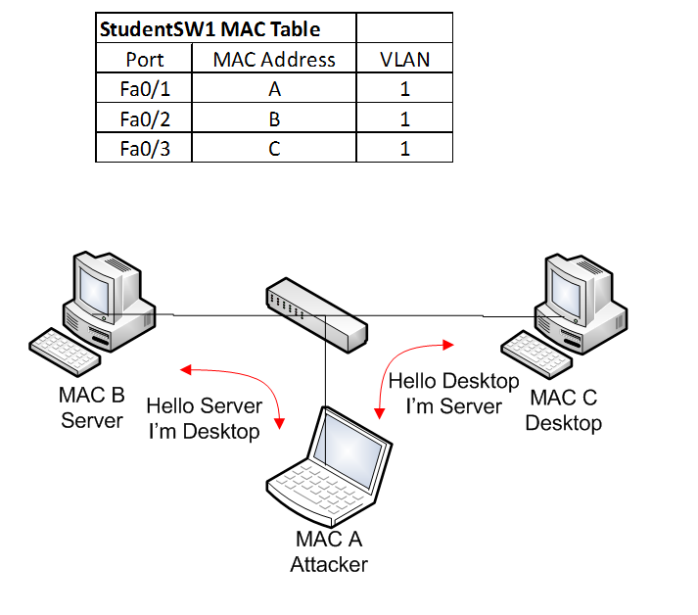
ARP Spoofing

Slide 75
ARP Spoofing Prevention
To mitigate ARP spoofing
Similar to MAC Spoofing Mitigation; and
Enable Dynamic ARP Inspection (DAI) on Switch
Intercepts all ARP requests (DHCP snooping) and responses on untrusted ports prevents a class of man-in-the-middle attacks
The switch drops ARP packet if the sender MAC address and sender IP address do not match an entry in the DHCP snooping bindings database
ip arp inspection vlan
Static ARP mappings.
A static mapping associates an IP address to a MAC address on a VLAN.
Useful when static IP addresses are used, DHCP snooping cannot be run, or other switches in the network do not run dynamic ARP inspection.

Slide 76
Discussion

Slide 77
VLAN Hopping

Slide 78
VLAN Hopping
A layer 2 network attack that targets the switch to gain access to a VLAN that is not accessible.
2 Types of attacks:
Posing as a switch connected with a VLAN trunk,
Double-tagging a VLAN to “hop” to another VLAN.

Slide 79
VLAN Hopping via Trunk Port
Posing as a switch, the attacking device can request the switch port to negotiate a trunk using Dynamic Trunking Protocol (DTP)
Once a trunk is established, the connected device can send and receive different VLAN traffic
Can access restricted VLANs (e.g., management VLAN)
This type of network attack is effective with physical access to the LAN environment

Slide 80
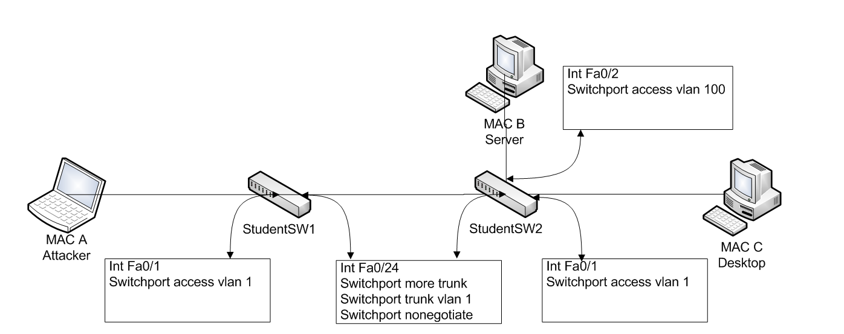
VLAN Hopping via Trunk Port

Slide 81
VLAN Hopping via Double Tagging
The double tagging attack is when connected to an interface in access mode with the same VLAN as the native untagged VLAN on the trunk.
The attacker sends a frame with two 802.1Q tags, the “inner” VLAN tag is the VLAN that we want to reach and the “outer” VLAN tag is the native VLAN.
When the switch receives the frame, it will remove the first (native VLAN) 802.1Q tag and forwards the frame with the second 802.1Q tag on its trunk interface(s).
The attacker has now “jumped” from the native VLAN to the victim’s VLAN. It’s a one way trip but it could be used perhaps for a DOS attack.

Slide 82
VLAN Hopping via Double Tagging
Tag
20
IP
Switch 1
Switch 2
IP
Tag
1, 20
IP
Attack Device
Victim
Device
VLAN 1
VLAN 20

Slide 83
VLAN Hopping Prevention
To mitigate VLAN hopping via trunk port:
Similar to MAC Spoofing Mitigation; and
Do not put any hosts on VLAN 1 (the default VLAN);
Change the native VLAN on all trunk ports to an unused VLAN ID;
Explicit tagging on the native VLAN on all trunk ports.

Slide 84
Discussion

Slide 85
DHCP Starvation

Slide 86
DHCP Starvation
Network attack targeting the exhaustion of a DHCP client IP from an authorized DHCP server
Using MAC address spoofing, an attacking device sends large numbers of DHCP requests using different “fake” MAC addresses
Once exhausted, the network DHCP server no longer has an available DHCP client IP to offer
This causes a Denial of Service (DoS) on the target network
DHCP starvation also serves as the basis of DHCP server spoofing attacks

Slide 87
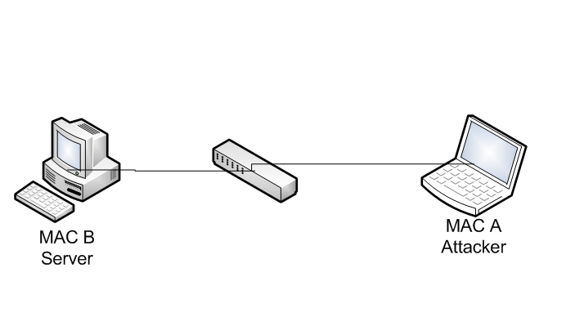
DHCP Starvation

Slide 88
DHCP Starvation Prevention
To mitigate a DHCP starvation attack
Similar to MAC Spoofing Mitigation; and
Enable DHCP snooping on switch to prevent an unauthorized DHCP server from responding to DHCP requests

Slide 89
Discussion

Slide 90
DHCP Server Spoofing

Slide 91
DHCP Server Spoofing
Network attack a rogue DHCP server poses as a legitimate DHCP server for the network segment
Since the DHCP server provides network gateway, DNS information, WPAD configuration, etc.,
DHCP server spoofing is the basis for many other higher-level network attacks, such as gateway spoofing, DNS spoofing and proxy spoofing

Slide 92
DHCP Server Spoofing
DHCP server spoofing relies on DHCP starvation attacks
If DHCP starvation attack is successful, the legitimate DHCP server no longer offers DHCP client IPs
The rogue DHCP server starts offering DHCP servers on the network from its own pool of IP addresses (typically from the exhausted pool of IPs obtained from the DHCP starvation attack)

Slide 93
DHCP Server Spoofing

Slide 94
DHCP Server Spoofing Prevention
To mitigate DHCP server spoofing
Similar to MAC Spoofing Mitigation; and
Enable Port security on switch, limits the number of MAC addresses connected to switch port
The attack relies on DHCP starvation attacks, mitigating DHCP starvation attacks also mitigates DHCP server spoofing
Enable DHCP snooping on switch to prevent an unauthorized DHCP server from responding to DHCP requests

Slide 95
Discussion

Slide 96
IP Spoofing

Slide 97
IP Spoofing
Network attack to hijack another IP address
Can hijack traffic destined for the target host
Builds on ARP spoofing to be successful
Attacker can repeatedly send G-ARP for a target IP address and redirects IP traffic to the attacker’s port
In its simplest form, attacker can change the IP address of a host and cause an IP address conflict (and DoS) on the target IP

Slide 98
IP Spoofing

Slide 99
IP Spoofing
To mitigate an IP spoofing attack
Similar to MAC Spoofing Mitigation; and
Use IP Source Guard to further restrict IP spoofing

Slide 100
Discussion

Slide 101
Spanning Tree Protocol Spoofing

Slide 102
Spanning Tree Protocol Spoofing
Network attack that changes the STP topologies to force network traffic to traverse a rogue network device
By controlling the rogue network device, attacker can sniff all passing network traffic and perform man-in-the-middle attacks

Slide 103
Spanning Tree Protocol Spoofing
Uses a rogue network device to pose as the ROOT bridge in a STP network
By injecting BPDU frames with the lowest priority, the rogue network device can become the elected ROOT bridge and change the topology in a STP network
Network traffic begins flowing through the ROOT bridge, allowing sniffing and man-in-the-middle attacks

Slide 104
STP Spoofing

Slide 105
STP Spoofing Prevention
To mitigate STP spoofing
Similar to MAC Spoofing Mitigation
Configure network ports with BPDU guard and ROOT guard
Configure non-trunk ports to switch access ports

Slide 106
Discussion

Slide 107
Private VLAN

Slide 108
Private VLAN
A private VLAN is used to provide additional segregation between all network hosts within the same VLAN
Especially useful for sensitive data servers that require port isolation to established secure hosting
A private VLAN includes Primary VLAN, Secondary VLAN (isolated and community), Promiscuous port, Isolated port and Community port

Slide 109
Private VLAN
 | Isolated Port | Promiscuous Port | Community Port
Isolated Port | Deny | Permit | Deny
Promiscuous Port | Permit | Permit | Permit
Community Port | Deny | Permit | Permit

Slide 110
Discussion

Slide 111
© 2017, Southern Alberta Institute of Technology. All rights reserved.
This publication and materials herein are protected by applicable intellectual property laws. Unauthorized reproduction and distribution of this publication in whole or part is prohibited.
For more information, contact:
Director, Centre for Instructional Technology and Development
Southern Alberta Institute of Technology
1301 16 Ave. N.W., Calgary, AB T2M 0L4

Slide 112
ITSC 206: Advanced Networking for Offensive and Defensive Environments
Lecture 3: Advanced Routing Protocols

Slide 113
Table of Contents
Review Lab 2
Routing Information Protocol (RIP)
RIP Attacks
RIP Attack Mitigation
Open Shortest Path First (OSPF)
OSPF Attacks
OSPF Attack Mitigation
Border Gateway Protocol (BGP)
BGP Attack
BGP Mitigation

Slide 114
Review Lecture & Lab

Slide 115
Review
MAC Address Spoofing
ARP Address Spoofing
VLAN Hopping
DHCP Starvation
DHCP Server Spoofing
IP Spoofing
STP Spoofing
Private VLan
Lab: Secure LAN

Slide 116
Routing Information Protocol (RIP)

Slide 117
RIP
Routing Information Protocol (RIP) is a distance-vector routing protocol
It uses hop count as a metric to measure distance
Maximum number of hops allowed: 15
A hop count of 16 is considered infinite and unreachable
Routing update sent out every 30 seconds using
broadcast in version 1
multicast in version 2

Slide 118
RIP
The frequency of routing updates tends to be relatively noisy on network
Because updates are sent every 30 seconds, there is a tendency for all RIP routers to send updates within seconds of each other, creating a storm of updates every 30 seconds, particularly in version 1
Version 1 does not support router authentication, making it prone to attacks

Slide 119
RIP: Split Horizon
Split horizon rule is used in RIP to prevent routing loop
Consider router A, B and C:
When A receives a route to C from B, it does not advertise back to B
This ensures B does not get an advertisement from A claiming that A has a route to C (via B) and creating a routing loop
A
X
B
C
Route to C

Slide 120
RIP: Route Poisoning
Used to prevent router from routing packets through an invalid network
RIP uses route poisoning to announce a route is no longer valid and should be removed from routing table
It does it by announcing a route with hop count 16, which marks it as unreachable, causing all RIP routers to remove the route from routing table
Route to Z Up/Down
Route to Z – hop 16
Route to Z – hop 16
Z
A
B
C
Remove route to Z
Remove route to Z
Remove route to Z

Slide 121
RIP Route Poisoning
RIP version 1 does not require authentication for route update
This allows rogue device to inject an illegitimate route into the routing tables of all participating RIP routers
Using route injection, an attacking device can poison the route to a network, effectively causing a denial of service attack

Slide 122
RIP: Hold-Down Timer
Used to prevent any subsequent route updates after a network is announced as unreachable
Used to prevent conflicting routing updates until the network converges after a change
Default hold-down timer is set to 180 seconds
Route to Z Up/Down
Route to Z – hop 16
Route to Z – hop 16
Z
A
B
C
Remove route to Z
Remove route to Z
Remove route to Z

Slide 123
RIP Route Injection
RIP version 1 does not require authentication for route update
This allows a rogue device to inject an illegitimate route into the routing tables of all participating RIP routers
Using route injection, an attacking device can inject a route to redirect all traffic through itself, and hijack network sessions by performing a man-in-the-middle attack

Slide 124
RIP Attack Mitigation
Do not use RIP version 1 (no authentication mechanism, it is susceptible to network attacks)
Choose a complex password for authentication in version 2 to prevent brute force attacks with password file
An inefficient routing protocol that is also unsafe if misconfigured
Implement ACL to prevent other than neighbor to send updates
Deprecated, do not use RIP if at all possible.

Slide 125
Discussion

Slide 126
Border Gateway Protocol (BGP)

Slide 127
Protocol Terminology
Interior Gateway Protocol (IGP)– the protocol used to exchange routing information within an autonomous system.
Exterior Routing Protocol (ERP)– the protocol used to transfer exchange information between autonomous systems.
Autonomous System (AS) – a set of routers with common routing rules, managed by one technical administrator and working with an IGP protocol (for routing within an AS, several IGP protocols can also be used).

Slide 128
Protocol Terminology (cont)
Transit autonomous system (transit AS) – autonomous system, through which traffic is sent to other autonomous systems.
Path – a sequence consisting of autonomous systems numbers through which must pass to reach the destination network.
Path attributes (PA) – path characteristics that help to choose the best path.
BGP speaker – a router that runs BGP protocol.

Slide 129
Protocol Terminology (cont)
Neighbors, peers – any two routers between which a TCP connection for exchanging routing information is open.
Network layer information about network availability (Network Layer Reachability Information, NLRI) – IP prefix and prefix length.
Operational algorithm -

Slide 130
BGP WAN
AS64001
AS65001
router bgp 64001
bgp log-neighbor-changes
bgp maxas-limit 50
aggregate-address 172.16.0.0 255.255.252.0 summary-only
redistribute connected
redistribute static
neighbor 10.200.200.1 remote-as 65001
neighbor 10.200.200.1 soft-reconfiguration inbound
router bgp 65001
bgp log-neighbor-changes
bgp maxas-limit 50
aggregate-address 172.16.3.0 255.255.252.0 summary-only
redistribute connected
redistribute static
neighbor 10.100.200.1 remote-as 64001
neighbor 10.100.200.1 soft-reconfiguration inbound

Slide 131
Border Gateway Protocol (BGP)
Standardized protocol used to exchange routing information between AS (Autonomous System) on the Internet
Used mostly in edge routers
BGP peers are set up manually between edge routers to exchange routing information
As the AS learns of a new route, the routing information is propagated to all peers
All learned routes are then processed and stored in RIB (Routing Information Base)

Slide 132
BGP – Best Path Selection Order
Algorithm not standardized, Cisco IOS selection order is
Don't consider routes if can't reach next-hop
Weight (highest)
Locally significant Cisco proprietary attribute
Local Preference (highest)
Locally originated routes
AS-Path (shortest)
Origin (lowest)
MED (lowest)
EBGP learned routes over iBGP learned routes
Smallest IGP metric to next-hop value
Algorithm runs top down until a deciding match occurs
Other tie-breaking checks occur if no bestpath
Oldest route, lowest Router-ID, lowest interface IP address, etc.

Slide 133
BGP
Limited built-in mechanism to protect against attack or error from peers
No mechanism to protect against modification, deletion, forging or replaying of data
Can be used as an attacking vector to destabilize a network
Advertises routes with any AS number
Can advertise an unassigned address prefix to perform prefix hijacking
Does not provide a global view of correct routing information to allow detection of invalid routes
Highly susceptible to false advertisement

Slide 134
BGP Impactful Events
1997 AS 7007 – Leaked internal routing table, blackholed part of Internet
2005 Google – Misconfiguration or hacked
2008 Pakistan / Youtube blocking – Internal leaked to whole internet
2010 China – Internal leaked routes redirected a portion of Internet to China
2012 Australia – Filtering failure lead to 30 min outage

Slide 135
BGP Hijacking (NLRI injection)
Since BGP is the standard protocol to exchange routing information on the Internet, hijacking BGP routes can have a great impact
If an edge router that exchanges routing information with an ISP using BGP is compromised, it is possible to broadcast external BGP announcement to perform BGP hijacking at the Internet
Previous BGP hijacking has been successful at rerouting traffic destined for a network to a controlled intermediate network device to perform man-in-the-middle attacks, or denial-of-service attacks

Slide 136
BGP Attack Mitigation
Use peer authentication with MD5
Use a complex password
Use system monitoring to detect attacks
Route filtering on inbound announcement (on the ISP side)
See https://tools.ietf.org/html/draft-jdurand-bgp-security-00

Slide 137
Discussion & Details
https://www.defcon.org/images/defcon-16/dc16-presentations/defcon-16-pilosov-kapela.pdf
https://bgpmon.net/how-the-internet-in-australia-went-down-under/

Slide 138
Open Shortest Path First (OSPF)

Slide 139
OSPF WAN
AS64001
AS65001
router ospf 10
router-id 172.16.3.1
auto-cost reference-bandwidth 10000
redistribute connected subnets
no passive-interface Fastethernet0
network 172.16.0.0 0.0.3.255 area 0
int Fa0
ip ospf network point-to-point
router ospf 10
router-id 172.16.7.1
auto-cost reference-bandwidth 10000
redistribute connected subnets
no passive-interface Fastethernet0
network 172.16.4.0 0.0.3.255 area 0
int Fa0
ip ospf network point-to-point

Slide 140
OSPF
Open Shortest Path First (OSPF) is an algorithm to determine the best route to a particular network based on link state
Uses MD5 for authentication
Link State Advertisement is used to communicate routing topology to other OSPF routers in the area
Maximum age of LSA is one hour
LSA uses sequence number to track updates. Larger sequence numbers indicate a fresher route

Slide 141
OSPF Route Injection
OSPF network without authentication can become a vector of attack
Route injection can be performed to force traffic through a compromised router and perform man-in-the-middle attacks
Route injection can also be used to blackhole access to networks, causing a denial-of-service attack
Other attacks include max age, sequence, max sequence

Slide 142
OSPF Max Age Attack (DOS)
Maximum age of an LSA is 3,600 seconds
Attacker can clone a fake LSA packet pretending to be from router A with the different max-age set
Router A contests the change in age by sending a new message called “fight-back”
Attacker can continuously send false LSA packets to cause network confusion and subsequently put the network into a denial-of-service attack

Slide 143
OSPF Sequence Attack (DOS)
Attacker can continuously send an LSA packet with a sequence number larger than the one from router A, which indicates a newer route is available
Router A will “fight back” with a newer sequence number LSA
Causes network to become unstable and subsequently put the network into a denial-of-service attack

Slide 144
OSPF Authentication Attack
OSPF uses MD5 key based authentication as part of the standard
Provides good protection on OSPF routers and LSA exchanges
However, it can be cracked using special tools and password files

Slide 145
OSPF Attack Mitigation
Authentication is the first line of defense
Always configure the OSPF network with authentication
Use complex password for OSPF authentication
Configure a passive interface on network interfaces that you don’t receive routing information (e.g., interface connecting to client networks)
Use system monitoring to detect attacks

Slide 146
Discussion

Slide 147
© 2017, Southern Alberta Institute of Technology. All rights reserved.
This publication and materials herein are protected by applicable intellectual property laws. Unauthorized reproduction and distribution of this publication in whole or part is prohibited.
For more information, contact:
Director, Centre for Instructional Technology and Development
Southern Alberta Institute of Technology
1301 16 Ave. N.W., Calgary, AB T2M 0L4

Slide 148
ITSC 206: Advanced Networking for Offensive and Defensive Environments
Lecture 4: Network Access Control

Slide 149
Table of Contents
Review Lecture 3, Lab 3 & Quiz 2
NAC
What is, How does it work,
Examples
Enterprise Usage
Components
Architecture
Architecture Flaws
Extensible Authentication Protocol

Slide 150
Review Lecture 3, Lab 3 Quiz 2

Slide 151
Lecture 3 & Lab 3 Review
Lecture
Routing Information Protocol (RIP)
RIP Attacks
RIP Attack Mitigation
Open Shortest Path First (OSPF)
OSPF Attacks
OSPF Attack Mitigation
Border Gateway Protocol (BGP)
BGP Attack
BGP Mitigation
Lab Review

Slide 152
Network Access Control (NAC)

Slide 153
What is Network Access Control?
Network Access Control (or Network Admission Control) is a method to control access to the network based on the identity of the connecting device and, optionally, its security posture.
In the days of bring-your-own-device (BYOD), any device could connect to network ports, whether corporate controlled devices or unknown.
It is crucial to deploy an extra layer of security at network ports to control what can and cannot connect to network resources.

Slide 154
How Does NAC Work?*****
When a device is connected to a NAC-enabled network port, the device is queried for user and/or machine authentication.
If the authentication is successful, the connecting device is assigned to the designated VLAN with authorized access to network resources.

Slide 155
How Does NAC Work?
If the connecting device (e.g., guest computer) fails to authenticate itself, it is quarantined into a remediation VLAN, where it is isolated (no access to network resources)
Device stays in quarantined VLAN until it is able to authenticate itself to gain network access

Slide 156
Examples of NAC
Most common NAC control deployment is a WiFi hotspot
A mobile device connects to the WiFi hotspot over an unencrypted WiFi network
Once connected, the device is assigned to a quarantine VLAN with a specific IP address given by the DHCP server

Slide 157
Examples of NAC
The mobile device is queried for an authentication process, typically a webpage with a form to enter a code or credential
If the device cannot authenticate against the WiFi hotspot, it is trapped in the quarantined VLAN with no network access
Once authenticated, the device is assigned to an authorized VLAN, given a new IP address by the DHCP server and allowed network access

Slide 158
Enterprise Usage
In an enterprise environment, NAC provide the first line of defense against unauthorized access from unknown devices.
Any person with access to a network port can connect an unknown device to the network port.
If the network port is not enabled with NAC, the unknown device is assigned to the configured VLAN for the network port, and assigned a valid IP address.

Slide 159
Enterprise Usage
Once an IP address and a gateway is assigned, the device has free access to all available network resources
The device may not have the same security measures as a corporate-controlled device
No security protection (antivirus)
May even be infected, ready to launch an attack on the network
Deploy NAC at network ports across the enterprise network to prevent unauthorized access to cross the front line

Slide 160
Discussion

Slide 161
NAC Components

Slide 162
Agent vs. Agentless
NAC makes decision on network port connectivity based on the intelligence it gathers from the connecting device
How it gathers information is the crucial step in the NAC architecture

Slide 163
Agent vs. Agentless
Agent-based NAC solution: designed to disclose system information using a client installed on the endpoint.
Network Access Protection (NAP): agent provided by Microsoft on the Windows platform to provide system information to NAC system
Agentless-based NAC solution: uses scanning techniques to query the system for information
(e.g., MAC address, NMAP scan)

Slide 164
Authentication
Determines the role of the connecting device and assigns appropriate enforcement policy
Typically uses the IEEE 802.1x as authentication mechanism for port-based NAC
Watch this clip for an overview of 802.1x https://www.youtube.com/watch?v=3obzgqslnL8
802.1x authentication has three components:
Supplicant
Authenticator
Authentication server

Slide 165
Authentication
Authentication server is the RADIUS server
Supplicant must first identify itself to the authenticator to access the protected side of the network
Using 802.1x port-based authentication, the authenticator challenges the supplicant to provide credentials (username/password or certificate)
Authenticator then forwards the credentials to authentication server for validation
Once credentials validated, supplicant can access the network resources assigned by the policy based on the role

Slide 166
Authentication Procedure
There are four main phases to consider:
Initialization
Initiation
Negotiation
Authentication
See https://en.wikipedia.org/wiki/IEEE_802.1X for complete description of authentication procedure

Slide 167
Security Posture
Another benefit of NAC is the assessment of security posture on the connecting device
NAC can perform security posture assessment to ensure connecting device is in compliance with the corporate policy

Slide 168
Security Posture
Assessment can include OS version, patch level, antivirus engine version, virus definition and OS firewall configuration
If connecting device failed the security posture assessment, it is assigned to the quarantine VLAN, where it can go through a remediation process to bring it into compliance level (e.g., update antivirus, definition, OS patch, firewall setting)

Slide 169
Discussion

Slide 170
NAC Architecture

Slide 171
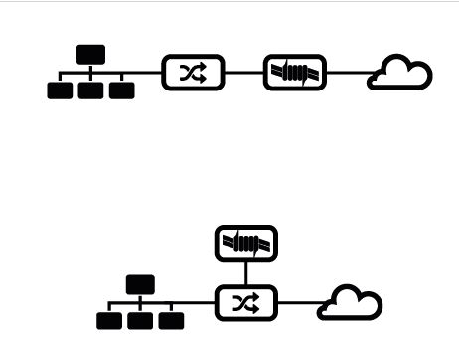
NAC Architecture
Inline
Out of Band

Slide 172
Inline System
Deployed in network path between switches and core routers
Typically includes multiple interfaces to accommodate multiple network paths through the system
Endpoint detection is achieved by listening to the IP traffic passing through the NAC device

Slide 173
Inline System
Since it is deployed inline in the network, an inline system doesn’t require an agent installed on endpoints to perform passive endpoint detection
Policy enforcement is done at the access layer of the network, because inline NAC has the ability to control individual packets passing through the inline NAC device, making it similar to an internal firewall

Slide 174
Inline System Weaknesses
Single point of failure: Device can be configured to “fail open” to avoid network outages, but loses the policy enforcement capability
Inline NAC limits network traffic throughput based on the processing speed of the hardware, requiring multiple NAC units deployed across an enterprise network and raising the implementation cost
Deployment of inline NAC requires architectural changes to network topology

Slide 175
Inline System Weaknesses
Typically deployed at the switch uplink, leaving local traffic on switches unprotected
Passive endpoint detection limits the amount of intelligence that can be gathered on endpoints
Vulnerability scanner is used to assess unmanaged endpoints
Firewalls on these endpoints limits the usefulness of these scans

Slide 176
Out-of-Band Systems
Typically use a span port on the switch to passively monitor traffic
The NAC console can send commands to network switches to enforce policy, such as assignment to quarantine VLAN
Enforcement option on the network switch is limited to the configuration allowed on switchport (e.g., VLAN assignment)

Slide 177
Out-of-Band Systems
Can be deployed to an existing infrastructure with ease
Optionally, agent can be installed on endpoint to report information to a central NAC console, allowing more enforcement options, such as remediation of out-of-date antivirus definitions

Slide 178
Out-of-Band System Weaknesses
Lacks the inline blocking capability
Requires a managed switch configurable via management protocol (e.g., SSH or SNMP) for quarantine and VLAN assignment
Span port on switches must be connected back to a central NAC controller, limiting the deployment with physical distance

Slide 179
Discussion

Slide 180
Architecture Flaws

Slide 181
Endpoint Detection Method
NAC solutions typically sniff network traffic to detect the presence of a new endpoint
This can be done by analyzing traffic for ARP request, SYN request, DHCP request or any other network traffic
DHCP request detection can be bypassed using a static IP

Slide 182
Endpoint Detection Method
SYN requests and IP network traffic detection can be bypassed by not generating network traffic crossing the inline NAC device
The attacking endpoint can stay silent on the LAN and target a specific host within its subnet without being detected
This allows the attacking endpoint to infect other endpoints on the same subnet, possibly taking control and acting as a launch pad for further network attacks

Slide 183
Exception Rules
Many devices within the network often lack the capability to respond to interrogation from the NAC system
E.g., a printer
Exception rules are used to handle these devices and allow them access to network without authentication

Slide 184
Exception Rules
Exception rules often rely on just the MAC address of the printer for identification. No other information is gathered.
An attacking endpoint can spoof the MAC address of printers within the network environment and gain access to network resources

Slide 185
Endpoint Security Assessment
Endpoint intelligence is gathered by the NAC solution to identify the OS version, patch level, antivirus engine version, virus definition, etc.
The information is typically stored in the OS registry system
A compromised machine can be modified to reflect falsified information to the NAC solution, gaining access to network without the actual required software (e.g., antivirus)

Slide 186
Discussion

Slide 187
Extensible Authentication Protocol

Slide 188
Overview
EAP is an authentication framework to provide authentication in wireless networks and point-to-point connections
Defines the message format used to deliver the keying material and parameters of EAP methods
EAP methods provides authentication functions and negotiation

Slide 189
LEAP
Lightweight Extensible Authentication Protocol
Developed by Cisco as part of 802.1x and dynamic WEP
Widely used by third-party client software for wireless devices
LEAP uses a modified version of MS-CHAP and has been exploited by ASLEAP
Mostly replaced by PEAP or EAP-TLS

Slide 190
PEAP
Second-most widely supported EAP standard
Protected EAP uses an encrypted TLS tunnel to encapsulate the EAP, providing higher security measure against attack
PEAP uses server-side public key for server authentication and server-side PKI certificate for the TLS tunnel creation

Slide 191
PEAP
PEAPv0 with EAP-MSCHAPv2 is the most common PEAP
Supported by Windows versions NT4 SP4 and later
Due to the use of MSCHAPv2, PEAP is susceptible to dictionary attacks if the password hash and the challenge response are captured

Slide 192
EAP-TLS
Most widely supported EAP standard
EAP Transport Layer Security adds TLS protocol to the EAP authentication framework
EAP-TLS is considered the most secure EAP standard
Widely supported by manufacturers of wireless communication technologies

Slide 193
EAP-TLS
EAP-TLS requires client-side X.509 certificate implementation to increase the authentication strength
With client-side certificate authentication requirement, a compromised password is not enough to break into EAP-TLS system

Slide 194
EAP-MD5
EAP-MD5 was the first implementation of EAP framework
EAP using MD5 has function to hash keys
It is vulnerable to dictionary attacks and does not support key generation
It only authenticates the EAP peer to EAP server, not mutual authentication, making it susceptible to man-in-the-middle attacks

Slide 195
EAP-TTLS
EAP Tunneled Transport Layer Security is an extension of TLS
The client can optionally authenticate to server using certificate, simplifying the deployment process (no client cert)
The server uses the secured tunnel established to authenticate the client using many authentication protocols
The authentication process is protected by the tunnel from eavesdropping and man-in-the-middle attacks

Slide 196
Discussion

Slide 197
© 2017, Southern Alberta Institute of Technology. All rights reserved.
This publication and materials herein are protected by applicable intellectual property laws. Unauthorized reproduction and distribution of this publication in whole or part is prohibited.
For more information, contact:
Director, Centre for Instructional Technology and Development
Southern Alberta Institute of Technology
1301 16 Ave. N.W., Calgary, AB T2M 0L4

Slide 198
ITSC 206: Advanced Networking for Offensive and Defensive Environments
Lecture 5: Network Address Translation and Web Proxies

Slide 199
Table of Contents
Module 4 Review
Network Address Translation (NAT)
NAT Types (One-To-One, One-To-Many, SNAT, DNAT, PAT)
NAT Scenarios
Web Proxies
Web Proxy Types
Explicit, Transparent, WCCP Redirection, Cloud
Web Proxy Features
Cache, Categorization, AV Scan, BW Control

Slide 200
Module 4: Review

Slide 201
Review
Mid Term
NAC
What is, How does it work,
Examples
Enterprise Usage
Components
Architecture
Architecture Flaws
Extensible Authentication Protocol

Slide 202
Network Address Translation

Slide 203
What is NAT?
Network Address Translation
The process of mapping one IP address to another by changing the IP address field in the Internet Protocol header
Performed as the IP packet passes through the NAT device

Slide 204
What is NAT?
NAT is typically used to map public (internet routable) IP addresses to mask private (non-internet routable) IP addresses.
Example: A host on the network with the IP address 192.168.1.9 is not routable on the Internet. To communicate with hosts on the Internet, a NAT must be performed to translate the private IP address to the public address for the network. Once the IP packet is NAT, return traffic can route back to the network properly.

Slide 205
Network Address Translation
Internal hosts can be assigned various internal (non-routeable) addresses eg
Range 1: Class A - 10.0.0.0 through 10.255.255.255 /8
Range 2: Class B - 172.16.0.0 through 172.31.255.255 / 12
Range 3: Class C - 192.168.0.0 through 192.168.255.255 /16
see RFC 1631
Increased the life span of IP v4
can be used for load balancing
can be used for back up links (multihoned)

Slide 206

Network Address Translation
10.1.1.1/192.168.123.1
Remote
Access
10.1.1.2
Internet
10.1.2.1/192.168.123.2
10.1.2.2
12.16.23.24
10.1.3.1/192/168.123.3
192.168.123.0/24
10.1.3.2
10.1.4.1/192.168.123.4
Internal Servers
10.1.4.2

Slide 207
Types of NAT

Slide 208
One-to-One NAT
Simplest NAT type is one-to-one NAT (RFC2663)
Translates IP addresses in a one-to-one relationship
Useful to connect networks that have incompatible (public vs private) or overlapping IP addresses

Slide 209
NAT One-to-One
External
Internal
12.16.23.24
192.168.123.2
12.16.23.25
192.168.123.3
Internet
12.16.23.26
192.168.123.4
12.16.23.27
192.168.123.5
12.16.23.24/30
DMZ
192.168.123.0/24

Slide 210
One-to-Many NAT
Used to map many hosts on the private IP to the public Internet
Translates private IP addresses to a single IP address (usually a public address on the firewall’s external interface)
This is useful to connect private IP networks to the public Internet

Slide 211
NAT One-to-Many
External
Internal
12.16.23.24
192.168.123.2
12.16.23.25
Internet
12.16.23.26
12.16.23.27
12.16.23.24/30
DMZ
192.168.123.0/24

Slide 212
SNAT
Source NAT (SNAT) is the address translation done on the packet’s source IP address
Useful to perform source NAT to hide the source IP address from the destination host or network because of routing issues (private IP RFC1918) or overlapping issues

Slide 213
DNAT
Destination NAT (DNAT) is the address translation done on the destination IP address of the packet
It is useful to perform destination NAT to translate allow access to the destination host or network that is non routable (Private IP RFC1918) or overlapping IP address

Slide 214
Port Address Translation (PAT)
Since one-to-many NAT uses one IP address for many IPs, it is also necessary to translate the port number (TCP or UDP) to create a distinct combination of IP address and port information on the return packet so that it can be mapped back to the corresponding originating source
Example: Outbound connection to the Internet
Host A IP: 192.168.123.98 src port 6845
Host B IP: 192.168.123.99 src port 6845

Slide 215
NAT One-to-Many
External
Internal
12.16.23.24
dst port 80
dst port 443
dst port 21
dst port 22
192.168.123.98 dst port 80
192.168.123.99 dst port 443
192.168.123.100 dst port 21
192.168.123.101 dst port 22
Internet
12.16.23.24/32
DMZ
192.168.123.0/24

Slide 216
NAT Scenarios

Slide 217
Hiding Behind a Public IP Address Using SNAT
Example: Outbound connection to the Internet
Host A IP: 192.168.123.98
Internet web server IP: 208.227.205.38
Firewall external interface IP: 193.38.56.247
Original Packet: Host A 192.168.123.98 > Internet web server 208.227.205.38
193.38.56.247/32
208.227.205.38
192.168.123.98
Internet

Slide 218
Hiding Behind a Public IP Address Using SNAT
After firewall NAT: Host A 193.38.56.247 > Internet web server 208.227.205.38
This allows host A with private IP 192.168.123.98 to access the Internet web server 208.227.205.38 using the firewall external IP by SNAT
The reply from the Internet web server can route back to the firewall external interface, then NAT back to host A on 192.168.123.98
193.38.56.247/32
208.227.205.38
192.168.123.98
Internet

Slide 219

Static NAT: Inbound to Web Server Using DNAT
Example: Inbound connection to web server from Internet
Web server IP: 192.168.1.34
Internet host IP: 209.89.23.29
Firewall external interface IP: 193.38.56.247
Original packet: Internet host 209.89.23.29 > Web server 193.38.56.247
192.168.1.34
193.38.56.247
208.98.23.29
Internet

Slide 220
Static NAT: Inbound to Web Server Using DNAT
After firewall NAT: Internet host 209.89.23.29 > Web server 192.168.1.34
This allows the Internet host 209.89.23.29 to access the web server via the firewall’s external interface IP 193.38.56.247
The firewall performs DNAT to translate the destination IP to 192.168.1.34 and forwards the packet to the web server
192.168.1.34
193.38.56.247
208.98.23.29
Internet

Slide 221
Port Address Translation (PAT)
Example: Outbound connection to the Internet
Host A IP: 192.168.1.98 src port 6845
Host B IP: 192.168.1.99 src port 6845
Internet web server IP: 208.98.23.29 dst port 80
Firewall external interface IP: 193.38.56.247
Original Packet: Host A 192.168.1.98:6845 > Internet web server 208.227.205.38:80

Slide 222
PAT
After firewall NAT: Host A 193.38.56.247:23456 > Internet web server 208.98.23.29 :80
Original Packet: Host B 192.168.1.99:6845 > Internet web server 208.98.23.29 :80
After firewall NAT: Host B 193.38.56.247:23457 > Internet web server 208.98.23.29:80

Slide 223
PAT
Since both hosts use TCP source port 6845 to go to the same web server (208.227.205.38), and both hosts’ source IP addresses are NAT to the firewall external interface IP, the source port number must be translated to different ports to differentiate the five tuples, to distinguish between the two connections and allow the firewall to route the return packet to the correct host

Slide 224
PAT
Host A connection five tuples after NAT: 193.38.56.247:23456 > 208.227.205.38:80 TCP
Host B connection five tuples after NAT: 193.38.56.247:23457 > 208.227.205.38:80 TCP
193.38.56.247:23456
208.98.23.29 port 80
192.168.1.98 port 6845
Internet
193.38.56.247:23457
192.168.1.99 port 6845

Slide 225
Discussion

Slide 226
Web Proxies

Slide 227
What is a Web Proxy?
Proxy is a device that acts as an intermediate to perform requests on behalf of the original requestor
As the name proxy implies, it represents the requestor and performs a request to a destination, and then relays the results back to the requestor
This is often seen as the “man-in-the-middle” method of accessing the web

Slide 228
What is a Web Proxy?
A Web proxy is one that specifically proxies web (HTTP or HTTPS) requests
However, most web proxies today can also proxy other protocols, such as FTP, CIFS and streaming media
http://www.google.ca
http://www.google.ca
User
Proxy
Google
Google HTML page
Google HTML page
© 2017, Southern Alberta Institute of Technology

Slide 229
Why Use a Web Proxy?
Protected hosts do not require a direct network connection to external Internet resources
With all outgoing web request proxied, firewall only needs to open Internet access for the proxy device, not the protected hosts; thus increasing security
All contents from web requests can be cached for performance enhancement

Slide 230
Why Use a Web Proxy?
All contents from web requests can be scanned at the network level by antivirus software to provide an extra layer of defense.
Web requests can be filtered based on the categories assigned to the website. This is useful to control users’ Internet behavior (e.g., deny pornography browsing).

Slide 231
HTTP Proxies
An HTTP proxy is the fundamental protocol for a web proxy
Detects and intercepts HTTP traffic by reading into the application header (layer 7), and proxies the connection at the application layer
An HTTP proxy presents itself as the destination web server to the connecting client computer and terminates the HTTP connection. Then, posing as a client computer, it re-establishes a new session to the real web server on the Internet

Slide 232
HTTP Proxies
For every web request, there are actually two sessions established: one from client computer to the proxy and one from the proxy to web server
The web proxy, in turn, can see everything in the HTTP request, including the text, the images and the passwords!
Since an HTTP proxy has the ability to see all passing web traffic, you must consider the legal implications when using one

Slide 233
HTTPS Proxies: SSL Interception
An HTTPS proxy is built on the HTTP proxy in a web proxy
It adds the SSL/TLS capability to the proxy engine
It performs HTTPS proxy service by detecting and intercepting HTTPS traffic, and performs the man-in-the-middle function to proxy the connection
Since SSL/TLS requires the careful handling of certificates, the HTTPS proxy is more complicated to set up:

Slide 234
HTTPS Proxies: SSL Interception
User accesses a web page using HTTPS protocol via web proxy.
Web proxy receives and intercepts the HTTPS request.
Web proxy creates a new session to the web page using HTTPS protocol.
Web proxy receives the certificate from the web page.
Web proxy rewrites the certificate for the web page with its own information.
Web proxy presents the rewritten certificate to the user to establish a HTTPS session.

Slide 235
HTTPS Proxies: SSL Interception
User sends encrypted HTTPS request to web proxy, web proxy decrypts the HTTPS request and terminates the request.
Web proxy re-encrypts the HTTPS request and sends it to the web page.
The reply from a web page uses the same decrypt-encrypt procedure in reverse
This setup requires the user computer to trust the certificate presented by the web proxy.
This can be achieved by pushing the proxy certificate to every client computer using Active Directory GPO.

Slide 236
Discussion

Slide 237
Types of Web Proxy

Slide 238
Explicit Proxy
A proxy is usually installed offline, away from a network path to the Internet
Access to the web proxy is explicitly defined in client’s computers
Requires proxy configuration on every client computer that uses the proxy
The explicit proxy configuration can be deployed to domain computers via active directory GPO

Slide 239
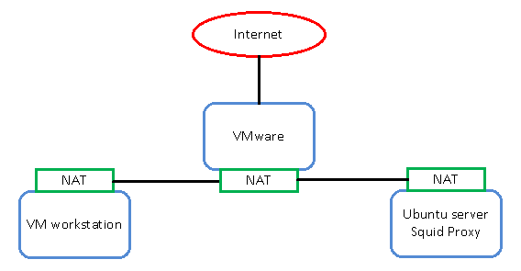
Explicit Proxy
Since the proxy setting is typically configured at the OS level, the OS can capture web traffic (HTTP and HTTPS) and redirect to web proxy regardless of the port number used by the web request (80, 443 or any other port numbers)
An offline proxy failure does not cause interruption to the Internet gateway

Slide 240
Transparent Proxy
Usually installed as an inline appliance, directly in the network path to the Internet (e.g., inline with the Internet firewall)
Since a web request goes out through the firewall, it is intercepted and, in turn, served by the transparent proxy
Simplifies the deployment, since no extra configuration is required on client computers

Slide 241
Transparent Proxy
The inline nature allows the transparent proxy to examine and capture all web requests regardless of the port numbers used (80, 443 or any other port numbers)
Inline nature also means a single point of failure to the Internet gateway
http://www.google.ca
http://www.google.ca
User
Proxy
Google
Google HTML page
Google HTML page

Slide 242
Web Cache Communications Protocol (WCCP) Redirection
In WCCP redirection, the proxy is deployed offline
A WCCP-enabled router is configured to redirect web requests to the proxy device for service
Client computers do not require extra configuration to use WCCP redirection

Slide 243
WCCP Redirection
Since the proxy is deployed offline, there is no interruption to Internet gateway in case of proxy failure
WCCP router must be configured to redirect web request based on specified port number (e.g., 80 and 443), therefore missing other web requests that use non-standard ports (e.g., 8080 or 8888)

Slide 244
Cloud-Based Proxy
Cloud based solution is suitable for proxying web requests for remote users with Internet access
Provides the same level of proxy protection as one inside the corporate network
Client computer is explicitly configured to use the cloud-based proxy when possible, and to default to direct Internet access when proxy is unreachable

Slide 245
Web Proxy Features

Slide 246
Web Cache
One of the main benefits of using a web proxy is the ability to cache web content
Statistically speaking, a good percentage of web requests are duplicates
When web caching enabled, duplicate requests can be served from cache memory, not the Internet
Saves valuable bandwidth and speeds up content fetch time

Slide 247
Web Categorization
Another benefit of web proxy is web categorization of content
Process of sorting every webpage available on the Internet into a collection of categories (typically from 80 to 100 categories)
Categories include gambling, nudity, financial services, malicious sources, scam/questionable and suspicious
Categorization is typically a paid subscription service, maintained by a reputable vendor

Slide 248
Web Categorization
Vendor uses web crawlers and intelligent services to select categories for a webpage
Subscriber can also submit categorization through portal if there is a dispute
As of 2016, Google has indexed 30 trillion web pages.
Due to number of new webpages created daily, often difficult to categorize the entire Internet
Many lesser known webpages are “unknown” until the crawl engine sweeps them up
Web categorization is and remains the most powerful tool for security administrators to control users’ browsing behavior

Slide 249
Blacklist and Whitelist
In addition to web categorization, web proxies typically support blacklists and whitelists
A blacklist is a list of webpages (URLs) that a security administrator wishes to block, regardless of the web category. Often used to block known malicious and off-limits pages.
A whitelist is a list of webpages (URLs) that an administrator wishes to allow, regardless of the category. Often used to allow connections to trusted partner sites and pages.

Slide 250
Blacklist and Whitelist
Blacklists and whitelists can create their own issues.
Since blacklists and whitelists are static, abuse can result in stale records in the list, often running into the thousands.
Becomes difficult to manage in the long run.
Careful use and periodic house-cleaning is required for these lists to remain effective

Slide 251
Antivirus Scanning
The third benefit of a web proxy is the ability to perform antivirus/antimalware scanning on web content received from the Internet
Since a web proxy is the man-in-the-middle, it sees all web content received from the Internet, and can scan the content before passing it on to client computers
Using the ICAP protocol, web content is passed to a dedicated appliance for antivirus scanning and results are passed to the proxy to allow or deny the web content to client computers

Slide 252
Bandwidth Control
Web proxies can also control bandwidth usage within an environment
Similar to QoS, bandwidth control is used to ensure sufficient bandwidth is available for all network hosts, especially when Internet gateway bandwidth is slow (in 10s of Mbit/sec)
Can restrict bandwidth usage to content such as YouTube videos, which may not be business related but which use large amounts of bandwidth, choking the Internet for business critical applications

Slide 253
Discussion

Slide 254
© 2017, Southern Alberta Institute of Technology. All rights reserved.
This publication and materials herein are protected by applicable intellectual property laws. Unauthorized reproduction and distribution of this publication in whole or part is prohibited.
For more information, contact:
Director, Centre for Instructional Technology and Development
Southern Alberta Institute of Technology
1301 16 Ave. N.W., Calgary, AB T2M 0L4

Slide 255
ITSC 206: Advanced Networking for Offensive and Defensive Environments
Lecture 6: Firewalls

Slide 256
Tables of Contents
Review Module 5
Firewall Basics & Types
Firewall Placement (Architecture)
Demilitarized Zone
UTM and Other Firewall Services
Defense in Depth
Firewall Maintenance

Slide 257
Review Module 5: NAT & Proxy

Slide 258
Review Module 5
Network Address Translation (NAT)
NAT Types (One-To-One, One-To-Many, SNAT, DNAT, PAT)
NAT Scenarios
Web Proxies
Web Proxy Types
Explicit, Transparent, WCCP Redirection, Cloud
Web Proxy Features
Cache, Categorization, AV Scan, BW Control

Slide 259
Firewall Basics

Slide 260
What is a Firewall?
A firewall is typically a layer 3 network device that filters traffic (layer 3 and above) in and out of a network
Generally used to prevent network attacks.
Computers inside a network usually do not have the necessary security protection from attacks and probes from outside networks.
A firewall is the first line of defence against these illegitimate attempts.

Slide 261
Firewalls Are Policy
Active Policy Enforcement
Unenforceable Policy
Effects of Unenforceable Policy
Vectors for Unenforceable Policy

Slide 262
Developing Policy
Identify Risks
Communicate Your Findings
Create or Update the Security Policy
Determine Policy Compliance
Sound Out Orgs Rules & Culture

Slide 263
The Basic Five Tuples
All firewalls leverage the basic 5 tuples to perform filtering:
Source IP address
Destination IP address
Source Port
Destination Port
Protocol Type (TCP, UDP, etc.)
The first 2 tuples define a layer 3 network connection between two network nodes that are communicating with each other

Slide 264
The Basic Five Tuples cont
The next two tuples define a distinct layer 4 conversation between the two network nodes
The last tuple defines the protocol type of the conversation
TCP (protocol number 6) is layer 4 connection-oriented
UDP (protocol number 17) is layer 4 connectionless
ICMP (protocol number 1) is layer 3 protocol that can be controlled by a firewall

Slide 265
Network Traffic Filtering
A firewall is the necessary evil that guards the network like a gate. It stops most unwanted traffic from crossing the gate, allowing legitimate traffic through
A firewall rule defines a network connection based on the five tuples, along with an assigned action to be performed
Actions can be Allow, Deny (Drop, Reset)

Slide 266
Network Traffic Filtering
“Allow” passes inspected traffic through without any modification
“Deny” blocks traffic either by silently dropping the connection or by sending a reset to close the connection (TCP-RST)

Slide 267
NAT and PAT
A firewall can also perform Network Address Translation (NAT) from a private IP address to a public IP address and vice versa in a one-to-one relationship
Port Address Translation (PAT) can be performed by a firewall to translate multiple IP addresses to a single IP address in a one-to-many relationship

Slide 268
Network Address Translation
10.1.1.1/192.168.123.1
Remote
Access
10.1.1.2
Internet
10.1.2.1/192.168.123.2
10.1.2.2
12.16.23.24
10.1.3.1/192.168.123.3
192.168.123.0/24
10.1.3.2
10.1.4.1/192.168.123.4
Internal Servers
10.1.4.2

Slide 269
Logging
A firewall has the capability to log all traffic (allow or deny) passing through it, for analysis purposes
Traffic logging allows security analysts to perform troubleshooting on the firewall rule set, as well as to post incident investigation

Slide 270
Discussion

Slide 271
Defense in Depth

Slide 272
Defense in Depth
Defense in Depth is a concept borrowed from military
The idea is simple:
Use multiple layers of defense to delay an incoming attack by yielding space to buy time
Because attackers must work through different defense layers to access internal resources, the attack has higher chance of being detected, giving the organization time to respond
In network security, defense in depth includes multiple layers of firewalls, DMZ, IDS/IPS, antivirus, web filtering, etc.

Slide 273
Defense In Depth (Remember)
Perimeter
Defenses
Internal
Defenses
Human
Defenses
273

Slide 274
Discussion

Slide 275
Firewall Defense

Slide 276
Static Routes
In the internal network, it is standard practice to run routing protocols to maintain the network topology
However, it is a standard security practice to use static routes when routing traffic to any firewall
Static routes prevent the dynamics of routing protocols to route packets around firewalls in the event an alternative route is introduced (e.g., as a network attack)

Slide 277
Firewall Management Access and Management Servers
Firewalls are essential tools for network security and should be hardened to protect them from unauthorized access
Individual firewalls should be configured to allow management access from dedicated jump servers or management servers
All other access to the firewall should be explicitly blocked and logged

Slide 278
Antispoof
Antispoof is a mechanism used to detect unexpected traffic arriving at an interface, and then perform predefined actions
In a well-designed firewall deployment, each interface expects traffic from a well-defined collection of networks
Untrust interface expects traffic from the Internet (e.g., source IP = 0.0.0.0/0 minus the RFC1918 addresses)
DMZ interface expects traffic from the DMZ networks (e.g., source IP = 172.16.0.0/12)

Slide 279
Antispoof
Trust interface expects traffic from the corporate networks (e.g., source IP = 10.0.0.0/8)
Example: Traffic with source IP 10.0.0.1 arriving at the Untrust interface triggers the antispoof
Ideally, drop all traffic triggering antispoof to prevent spoofing attacks

Slide 280
Connection Table: Memory Issue
Every stateful firewall contains a connection table to track connections’ state
Established connections with continuous activity remain in the connection table until closed or dropped
Idle connections remain in the connection table until the timeout expires (default TCP timeout is 3,600 seconds)

Slide 281
Connection table - memory issue
Connection table resides in the memory for fast process, thus every connection takes up available memory
Most firewalls have enough memory for million+ connections, but it is important to monitor the connection table to prevent memory exhaustion
When connection table is full, firewalls will continue to process existing connections but will not allow new connections to be established

Slide 282
NAT Table, NAT Exhaustion
NAT (PAT) is used as a primary function in edge firewalls to allow communication to the Internet without assigning a public IP address to every network host
In small to medium enterprises, it is typical to configure firewall NAT with a single public IP address for outbound Internet access

Slide 283
NAT Table, NAT Exhaustion
With a single public IP address, the available source port is 64 K
With a large number of active network connections, possible to exhaust all available source ports in the NAT table, causing the firewall to stop NAT for new connections
To prevent NAT exhaustion, use public IP pool instead of a single public IP address for NAT

Slide 284
Throughput Considerations
Firewalls perform inspection at layer 4 and above
Because of the additional processing required for inspections, processing time is often penalized
Firewalls use CPU resources to process traffic. Too much throughput causes high CPU usage, resulting in dropped packets.
Typical firewall can inspect traffic in the range of 100 Mbps, while enterprise-class firewalls can inspect traffic in the range of 1 Gbps
Consider the throughput requirement when designing a firewall deployment

Slide 285
Drop ANY ANY
Firewalls usually have an implicit DROP rule at the bottom of the rule set
Used to block all traffic passing through the firewall by default
However, it is useful to define an explicit DROP rule with manual logging for the purpose of troubleshooting

Slide 286
The ANY ANY Rule
Often used in zone-based firewall, the ANY (source) ANY (destination) rule is handy to allow ANY traffic from one zone to another (e.g., Trust to Untrust)
In non-zone based firewalls, the ANY ANY rule is typically avoided, due to unexpected consequences in firewalls with multiple interfaces
For example, an ANY ANY rule can allow:
Any host on the internal network to access the Internet (intended)
Any host on the Internet to access the internal network (unintended)
It is a standard security practice not to use ANY in the five tuples. Always explicitly define them.

Slide 287
Discussion

Slide 288
Other Firewall Maintenance

Slide 289
Other Firewall Maintenance
Back up and restore: An integral part of firewall management. Since firewalls are typically installed at the choke point within a network, it is crucial to have minimal downtime in the event of an incident.
Log management: Firewall logs can aid in troubleshooting connectivity issues, and serve as evidence in a security incident. Store all firewall logs in a secured repository and protect them from tampering (log manager, SIEM).
Ruleset version control: If firewall management supports version control, use it as a quick rollback mechanism in case of an issue with a change in firewall rules.

Slide 290
Discussion

Slide 291
Firewall Types

Slide 292
Packet Filtering Firewall
The most basic type of firewall
Works at layer 3, similar to a router, with different networks on each interface
Filters traffic at layer 3 according to the five tuples in the rules
Does not maintain the state of the traffic. An administrator must create a rule for each traffic direction (initiate and return traffic)

Slide 293
Packet Filtering Firewall
Example: To allow traffic from host A to web server B on TCP port 80 (HTTP) traffic, the administrator must create the following two rules:
Host A on any port > Web Server B on port 80 on TCP protocol, allow (the “initiate” traffic)
Web Server B on port 80 > Host A on any port on TCP protocol, allow (the “return” traffic)

Slide 294
Network Filtering Layer 3/4

Slide 295
Stateful Firewall
Has the intelligence to maintain the “state” of a network connection, and to account for the return traffic
Uses computing resources to examine a connection at the initiation phase, and tracks the connection in a connection table
When the return traffic arrives at the firewall, it performs a lookup at the connection table and automatically allows the return traffic through

Slide 296
Stateful Firewalls
Example: To allow traffic from host A to web server B on TCP port 80 (HTTP) traffic, the administrator only needs to create one rule
Host A on any port > Web Server B on port 80 on TCP protocol, allow (the “initiate” traffic)
Connection is maintained in the connection table and return traffic is automatically allowed through

Slide 297
Stateful Filtering Still @ Layer 3/4

Slide 298
Zone-Based Firewalls
Further development on firewalls allows the definition of network “zones” associated with individual interfaces
Trust zone: the network inside the firewall (the corporate network)
Untrust zone: the network outside the firewall (the Internet)
DMZ zone: the network dedicated between Trust zone and Untrust zone, mostly used for hosting web services

Slide 299
Zone-Based Firewalls
Rules can be written specifically from one zone to another, simplifying rule set management
Example: To allow all outbound Internet traffic from a corporate network to the Internet:
Trust zone to Untrust zone, allow ANY host to ANY destination on port 80 (HTTP)

Slide 300
Transparent Firewall
Filters traffic based on firewall rules written with the five tuples, but examines and intercepts traffic at layer 2
Interfaces are grouped into bridges (layer 2), with the firewall inserted into the bridge transparently
Transparent firewalls do not require a layer 3 network for connectivity
Useful for adding a firewall transparently inline into existing network without changing topology

Slide 301
Transparent @ Layer 2

Slide 302
Application Firewall (NextGen): L7
Application aware and understands application session information
Filters traffic based on layer 7 properties
Often user identity aware (AD integrated) to allow rule definition at user and group level
Example: Allow management group access to Facebook
Allow AD_GRP_Management to www.facebook.com on port 80 and 443 (HTTP, HTTPS)

Slide 303
Applicaton FW @ Layer 7

Slide 304
UTM: Firewall and Other Services
Unified Threat Management is a traditional (stateful) firewall that can also perform other security functions, such as:
Anti-Virus and/or Anti-Spam;
Web Proxy;
White/Black Listing
Application Control / ID
User Identity
Intrusion Detection System and/or Intrusion Prevention System;
Virtual Private Network and
Web Filtering

Slide 305
UTM: Firewall and Other Services cont
The “all-in-one” approach, functions enabled simply by purchasing a license
Ideal for small to medium enterprises due to reduced cost and reduced hardware footprint

Slide 306
Discussion

Slide 307
UTM and Other Firewall Services

Slide 308
Web Proxies and Filtering
A web proxy is an intermediate device that “proxies” Internet web access to minimize corporate computers’ exposure to the Internet
Using a middleman approach, a web proxy can also cache the content of web pages for speed and bandwidth optimization, as well as perform web content filtering based on categorization (e.g., blocking pornography and malicious websites)

Slide 309
Domain / IP Black Listing
Domain and/or IP black listing using threat intelligence to block external access
Vendor Threat Intel used

Slide 310
Anti-Malware Tools
Since network traffic passes through the firewall, network based anti-malware tools can be applied to all network traffic, adding an extra layer of security against malware
Using both static (hash signature) and/or dynamic file analysis
Dynamic file analysis typically consists of file submission to service to perform various functionality up to and including file execution

Slide 311
Anti-Spam Tools
Similar to anti-malware, network based anti-spam tools can be used on all email traffic passing through the firewall, adding an extra layer of security against spam and phishing attacks

Slide 312
User Identity
Next Generation (NextGen) firewalls usually come with user identity awareness, to allow specific users or groups, instead of the traditional source IP address in the firewall rule
Typical integration includes Active Directory and/or LDAP
There are challenges with implementing this control effectively

Slide 313
Application Control / ID
Use of firewall to identify the application transiting and confirm it behaves as expected (use of port / signaling / comms) and determine if operating within preset parameters
Limitations to depth of packet analysis by each technology vendor (Cisco FP vs Palo Alto vs Check Point)

Slide 314
Intrusion Detection Prevention System
With visibility of all passing network traffic, network based IDS/IPS can also be deployed at the firewall
Typically signature based (Snort)

Slide 315
VPN
Most firewalls include VPN termination as a standard feature
Basic implementation supports site-to-site VPN (e.g., IPSec) and remote access for users (e.g., SSLVPN)

Slide 316
Web Filtering
Most UTM firewalls include Web filtering as a feature
Basic implementation supports site categorization and policy implementation

Slide 317
Discussion

Slide 318
Firewall Placement

Slide 319
Edge Firewall
Installed at the edge of the corporate network, connecting to an external network (e.g., ISP or Partner network)

Slide 320
Edge Firewall
10.1.1.1/192.168.123.1
Remote
Access
10.1.1.2
Internet
10.1.2.1/192.168.123.2
10.1.2.2
12.16.23.24
10.1.3.1/192.168.123.3
192.168.123.0/24
ICS
Systems
10.1.3.2
10.1.4.1/192.168.123.4
Internal Servers
10.1.4.2

Slide 321
Internal Firewall
Installed inside the corporate network, to protect specific groups of networks (e.g., network access to data centre)

Slide 322
Internal Firewall
10.1.1.1/192.168.123.1
Remote
Access
10.1.1.2
Internet
10.1.2.1/192.168.123.2
10.1.2.2
12.16.23.24
10.1.3.1/192.168.123.3
192.168.123.0/24
ICS
Systems
10.1.3.2
10.1.4.1/192.168.123.4
Internal Servers
10.1.4.2

Slide 323
ICS Firewall
Internal firewall typically used to protect the ICS environment
A simpler way to access the ICS would be to allow direct access from a corporate network to an ICS network via the ICS firewall
However, this allows a compromised corporate asset to launch attacks on the ICS through the allowed communication channel on the ICS firewall
A more secure approach would be adding a DMZ between the corporate network and the ICS, using a security hardened jump server in the DMZ to access the ICS network

Slide 324
ICS Firewall
10.1.1.1/192.168.123.1
Remote
Access
10.1.1.2
Internet
10.1.2.1/192.168.123.2
10.1.2.2
12.16.23.24
10.1.3.1/192.168.123.3
192.168.123.0/24
ICS
Systems
10.1.3.2
10.1.4.1/192.168.123.4
Internal Servers
10.1.4.2

Slide 325
Host-Based Firewall
Installed on individual host (software) to protect traffic in and out of a host
It is effective at stopping attacks from within the network, where network-based security solutions do not have visibility
Windows firewall and Symantec Internet Security are examples of host-based firewalls

Slide 326
Host Based Firewall
10.1.1.1/192.168.123.1
Remote
Access
10.1.1.2
Internet
10.1.2.1/192.168.123.2
10.1.2.2
12.16.23.24
10.1.3.1/192.168.123.3
192.168.123.0/24
ICS
Systems
10.1.3.2
10.1.4.1/192.168.123.4
Internal Servers
10.1.4.2

Slide 327
Discussion

Slide 328
Demilitarized Zone

Slide 329
DMZ Firewall
10.1.1.1/192.168.123.1
Remote
Access
10.1.1.2
Internet
10.1.2.1/192.168.123.2
12.16.23.24
10.1.2.2
10.1.3.1/192/168.123.3
192.168.123.0/24
ICS
Systems
10.1.3.2
172.16.0.0/24
10.1.4.1/192.168.123.4
Internal Servers
External Facing Servers
10.1.4.2

Slide 330
Demilitarized Zone
Also known as a perimeter network, is an isolated network that sits between the corporate trusted network and untrusted networks like the Internet or partner network
Useful buffer zone to allow an organization to install dedicated servers and services to gain access to resources in the other network, without exposing internal resources

Slide 331
Demilitarized Zone
Example: Front-end email server in DMZ receives emails from the Internet, and then relays them to an internal email server through a secured channel.
This allows an organization to receive emails from the Internet without directly exposing the internal email server to the Internet
Example: Web proxy in DMZ allows corporate computers to access the Internet as an intermediate device, without exposing the computers directly to the Internet

Slide 332
Discussion

Slide 333
© 2017, Southern Alberta Institute of Technology. All rights reserved.
This publication and materials herein are protected by applicable intellectual property laws. Unauthorized reproduction and distribution of this publication in whole or part is prohibited.
For more information, contact:
Director, Centre for Instructional Technology and Development
Southern Alberta Institute of Technology
1301 16 Ave. N.W., Calgary, AB T2M 0L4

Slide 334
ITSC 206: Advanced Networking for Offensive and Defensive Environments
Lecture 7: IDS/IPS

Slide 335
Table of Contents
Module 6 Review: Firewall Basics
IDS
IPS
Types of IDS/IPS
Detection Methods
IDS/IPS Example
How IPS Snort Works

Slide 336
Review Module 6: Firewall Basics

Slide 337
Review Module 6
Firewall Basics & Types
Firewall Placement (Architecture)
Demilitarized Zone
UTM and Other Firewall Services
Defense in Depth
Firewall Maintenance

Slide 338
Intrusion Detection System (IDS)/Intrusion Prevention System (IPS)

Slide 339
Intrusion Detection System (IDS)
An IDS is a network device that monitors network traffic behavior and analyzes it for specific activity that stands out from the “norm” or matches a signature database of network attacks
IDS is deployed offline and can’t intercept the offending network intrusion when identified. It mostly serves as an alert to a network condition only, not as a defence mechanism

Slide 340
Intrusion Prevention System (IPS)
An IPS is a network device that is deployed inline with network traffic and analyzes it for malicious network activities and then actively blocks the network connections upon detection
IPS provides real-time protection against network attacks, at the expense of milliseconds delay
Since IPS has the added benefit over an IDS of intercepting malicious network activities, most current intrusion systems are IPS

Slide 341
Type of IDS/IPS

Slide 342
Types of IDS
Network based IDS (NIDS):
Monitors network traffic at the network level
Usually done by sending traffic through a network tap or creating a span port on a network switch
Looks for suspicious network activity across the network
Requires a network choke point to be effective (e.g., at the network DMZ, WAN core router, or network entry into a data center)

Slide 343

Firewall w/ IDPS
10.1.1.1/192.168.123.1
Remote
Access
10.1.1.2
Internet
10.1.2.1/192.168.123.2
12.16.23.24
10.1.2.2
10.1.3.1/192.168.123.3
192.168.123.0/24
ICS
Systems
10.1.3.2
172.16.0.0/24
10.1.4.1/192.168.123.4
Internal Servers
External Facing Servers
10.1.4.2

Slide 344
Types of IDS
Host based IDS (HIDS):
Installs on a host (e.g., computer or server) and monitors activities crossing the host’s network interface
Can be considered a distributed model to provide best coverage of IDS across the IT infrastructure
Requires extra system resources to run the HIDS program on the host computer

Slide 345
Types of IPS
Network based IPS (NIPS):
Inspects and intercepts network traffic at the network level
Deployed inline with the network, thus requiring a network choke point to be effective
Typically offered as a fail-open or fail-close device
Fail-open: In the event of a hardware (or software) failure, the device will fail-open to allow network traffic to continue to flow through uninterrupted. Usually required for performance over security deployment, where network connectivity is more important than network protection (provides Internet connectivity).

Slide 346
Types of IPS
Fail-close: In the event of a hardware (or software) failure, the inline device will fail-close to stop all network traffic flow through the device. This is usually required for security over performance deployment, where protecting the network is more important than network connectivity (protecting highly sensitive data)
Host based IPS (HIPS):
Same as HIDS but additionally can intercept and block malicious network activities

Slide 347
Discussion

Slide 348
Detection Methods

Slide 349
Signature-Based Detection
A signature database that contains specific, known network attacks to compare against monitored traffic
Requires a pre-written signature to identify network attacks, which lowers the false positive rate, but which does not address zero-day network attacks

Slide 350
Stateful Protocol Analysis
Compares the traffic behavior with the normal profile of network protocols, and identifies an anomaly when network traffic deviates from the normal profile

Slide 351
Statistical, Anomaly Based Detection
A network traffic baseline is first established as the “norm”
Continuous network monitoring looks for anomalies in traffic patterns and attempt to identify whether an intrusion event has occurred
Often results in excess false alarm, but is able to identify anomaly behavior which could serve as an indication of a zero-day network attack

Slide 352
Discussion

Slide 353
IDS/IPS Examples

Slide 354
Proprietary vs. Open Source
There are many proprietary IDS/IPS solutions on the market today
Most of them leverage a proprietary signature database and scanning algorithm

Slide 355
Proprietary vs Open Source
Snort is the most popular open-source IDS/IPS solution
It uses protocol analysis and content matching to analyze real-time traffic
Snort runs in three modes: Sniffer, Packet logger and Intrusion detection
Sniffer monitors and displays packets on console
Packet logger captures and logs packets to disk
Intrusion detection monitors and analyzes network traffic against user-defined rules

Slide 356
Discussion

Slide 357
How Snort IPS Works

Slide 358
Snort Architecture
SNORT ARCHITECTURE
Packets from libpcap
Ruleset
Alert / Log Database
Packet Decoder
Pre-processors
Detection Engine
Alert / Log Output
Console Alerts
© 2017, Southern Alberta Institute of Technology

Slide 359
Packet Decoder
Used to determine the underlying protocols used in packets (e.g., TCP, UDP, IP)
Also looks for errors and anomalies in the protocol headers
Example of header error would be an IPv4 header with less than 20 bytes
HTTP_decode is used to detect anomalies in HTTP traffic and process HTTP traffic for the detection engine

Slide 360
Pre-Processor
Examines the packet for malicious activity and processes the packet for the detection engine to use
Stream4 is an example of preprocessor that tracks the state of TCP stream
It performs a stateful inspection of packets to allow a detection engine to better match an attack signature over several packets

Slide 361
Detection Engine
Performs two main functions:
Rules parsing
Signature detection.
Detection engine parses the Snort rules and creates the attack signature from the configured rules
Rules are written in two parts:
Rule Header
Rule Option

Slide 362
Detection Engine
Rule Header
Rule Options
Alert tcp 1.1.1.1 any -> 2.2.2.2 any
(flags: SF; msg: “SYN-FIN Scan”;)
Alert tcp 1.1.1.1 any -> 2.2.2.2 any
(flags: S12; msg: “Queso Scan”;)
Alert tcp 1.1.1.1 any -> 2.2.2.2 any
(flags: F; msg: “FIN Scan”;)
Rule header contains the action, protocol, source address, source port, destination address, destination port
Rule option contains the message, flags, content to match, reference, sid, classtype, revision number, etc.

Slide 363
Alert/Log Output
Depending on the rule action, the output module processes the output data to alert and log database, or displays the alert on the console output
FAST, FULL, CONSOLE, CMG, NONE, SYSLOG are different output modes available in Snort

Slide 364
Discussion

Slide 365
© 2017, Southern Alberta Institute of Technology. All rights reserved.
This publication and materials herein are protected by applicable intellectual property laws. Unauthorized reproduction and distribution of this publication in whole or part is prohibited.
For more information, contact:
Director, Centre for Instructional Technology and Development
Southern Alberta Institute of Technology
1301 16 Ave. N.W., Calgary, AB T2M 0L4

Slide 366
ITSC 206: Advanced Networking for Offensive and Defensive Environments
Lecture 8: VPN

Slide 367
Table of Contents
Module 7 Review
Motivation
Business Drivers
Threats from the Internet
What is VPN
Types of VPN
Algorithms
IPSEC
SSL/TLS VPN
PPTP VPN

Slide 368
Virtual Private Networks (VPNs)

Slide 369
Review Module 7
IDS
IPS
Types of IDS/IPS
Detection Methods
IDS/IPS Example
How IPS Snort Works

Slide 370
Virtual Private Networks (VPNs)

Slide 371
Motivation
Remote Access
Dramatic increase in telecommuting and mobile work force
Reduce costs by using local access to internet, rather than long distance or “toll free” service
Intranets
High cost of implementing and maintaining private networks
Reduce costs by removing point-to-point leased lines and make broader use of internet connectivity
Extranets
Secure transactions on-line with suppliers and business partners
Reduce cost by eliminating dependence on dedicated connections

Slide 372
Business Drivers
Cost
Eliminate remote access equipment, toll costs, leased lines
60 - 80% operational savings
SVPN equipment payback 4-6 months
Leverage the Internet
global connectivity
instant scalability
thousands of users or nodes
variety of connectivity options
modem, ISDN, cable modem, xDSL
multi-vendor interoperabitity

Slide 373
Threats From the Internet
IP Spoofing
Eavesdropping (sniffing)
Session Hijacking
Man-in-the-Middle attack
Authentication Replay
Attacker “sniffs” valid authentication information and uses it again to create additional authenticated sessions

Slide 374
Security Services - Secure VPNs
Confidentiality
prevent disclosure of data communications
Integrity
detection of data modification
Authentication
positive identification of network users
protection against spoofing attacks
Network access control (VPN policy)
access privileges for the network & resources

Slide 375
What is a VPN?
A Virtual Private Network (VPN), as the name implies, is a private network that is virtualized over a public network using encapsulation and encryption technologies
VPN is typically deployed over the Internet, but it can also be used within private networks or over WAN or carrier networks (e.g., MPLS) to provide confidentiality and integrity on the communication channel

Slide 376
What is VPN?
Confidentiality: VPN applies encryption on the VPN traffic to protect against network sniffing
Integrity: Message integrity is provided to ensure VPN traffic is free from tampering
Authentication: Prevents unauthorized access to the VPN service

Slide 377
Types of VPN: Site-to-Site VPN
Used to connect sites from different locations, usually back to headquarters, securely over the public network (e.g., Internet)
Used to extend the corporate network to branch offices, making network resources available through the VPN at the Internet layer (L3)
Established between network gateways, so individual computers do not need to run VPN software to access the other sites

Slide 378
Gateway-To-Gateway
SA
Intranet/Internet
H1
G1
G2
H2
Local Intranet
Local Intranet
Only Tunnel Mode Allowed
[IP2][AH][HP1[payload]
[IP2][ESP][IP1][payload]

Slide 379
Types of VPN: Remote Access VPN
Allows remote user to establish secured connections to the corporate network from a remote location
Users can access the corporate network resources via the VPN as if they were directly connected to the network

Slide 380
Types of VPN: Remote Access VPN
Remote user has VPN client software that connects to the corporate VPN server, performs authentication and establishes the VPN tunnel to the corporate network
Suitable for individual users who are roaming but still require connectivity to corporate resources

Slide 381
Remote VPN - Host-To-Gateway
SA1
Intranet/Internet
H1
G2
H2
Remote Host
Local Intranet
Note: Requires special processing of the IPSec header order

Slide 382
Remote Access Authentication
Username and password: Remote access authentication requires, at minimum, a username and password login. Authentication is typically tied in with Active Directory to allow users to use Windows login for remote access
AAA: Smaller implementations may choose to authenticate user with an AAA server, and maintain user credentials in a simplified database inside a Radius server

Slide 383
Remote Access Authentication
2FA (two factor authentication): used to increase security on remote access authentication
Requires the user to have two of the following factors for authentication:
Something you know (secret, password)
Something you have (tokens, USB key)
Something you are (fingerprint, retina scan)
Username and password is a good first factor authentication (something you know). RSA token or Google Authenticator are good options for the second factor authentication (something you have)

Slide 384
Algorithms

Slide 385
Symmetric Encryption Algorithms
DES (Data Encryption System)
64-bit input blocks, 16 round processing, 56-bit key
Since key space quite small, it has been broken
2DES
Double the encryption of DES (two 56-bit keys)
Because vulnerable to meet-in-the-middle attack, it has been broken
3DES
In simplest terms, performs DES three times
Effective key strength is 168 bit.
Considered a legacy algorithm, replaced by more advanced algorithms like AES

Slide 386
Symmetric Encryption Algorithms
CCMP
Counter mode with cipher block chaining message authentication code protocol
Part of 802.11i standard for WiFi networks
Based on AES using CTR with CBC-MAC
Rijndael (AES128, AES256)
Finalist for the AES standard,
Block size: 128, 192 or 256 bits (AES implementations use only 128 bit block size)
Key size: 128, 192 or 256 bits, variable rounds.
Four major operations: substitute bytes, shift rows, mix columns and add round key

Slide 387
Asymmetric Encryption Algorithms
RSA
Popular public key cryptosystem, based on mathematical challenge of prime number factoring.
Public key, based on two large prime numbers, is used to encrypt the message. Only the private key with the prime numbers can decrypt the message
Diffie-Hellmann Algorithm
Key exchange algorithm used to create a secret symmetric key between two parties over public networks
Used heavily in PKI
Does not include message confidentiality

Slide 388
Asymmetric Encryption Algorithms
El Gamal
Based on Diffie-Hellmann but includes message confidentiality and digital signature
ECC
Highest strength per bit
Fast and efficient on resource-constrained devices, such as cell phones and smart card readers
Includes confidentiality, digital signature and message authentication

Slide 389
Internet Protocol Security (IPSec)

Slide 390
IPSec Overview
Internet Protocol Security (IPSec) is one of the most common VPN protocols used today
Works at the Internet layer (L3) of the OSI model, securing all data communication layer 3 and above

Slide 391
IPSec Overview
A suite of network protocols that work together to provide authentication and encryption of data packets over a network
Provides security for gateway-to-host (remote access) or network-to-network (site-to-site) connections

Slide 392
Authentication Header (AH)
AH is used to authenticate IP traffic but doesn’t encrypt it
AH uses HMAC (MD5 or SHA) to validate the authenticity and integrity of a message
IP
AH
Payload
Signature

Slide 393
IPSec Authentication Header
IP Header
AH
Payload
Next Header
Payload length
Reserved
Security Parameters Index
Sequence Number
Authentication Data (variable size)
32 bits

Slide 394
Encapsulating Security Payload (ESP)
ESP includes the encryption and authentication of a payload in the IPSec protocol suite
Provides authenticity, confidentiality and integrity of the payload
Can be implemented with or without authentication, although without authentication is insecure
IP
ESP
Encrypt
Transport & data
Signature

Slide 395
Encapsulating Security Payload (ESP)
Can also be implemented with an encryption algorithm (e.g., DES, 3DES, AES) to provide confidentiality
Can be implemented with a NULL algorithm to forego confidentiality and use only the authentication feature (similar to AH)

Slide 396
IPSec ESP Packet
IP Header
ESP Header
Payload
ESP Trailer
ESP Trailer
32 bits
Security Parameters Index
Sequence Number
Encryption
Encryption
Padding
Padding
Pad Length
Next Header
Authentication Data (variable size)

Slide 397
Transport Mode
One of two modes IPSec operates in
Encapsulates the payload only and is used for communication between two hosts
IP protocol headers are left untouched
If authentication header is used, performing NAT will break transport mode because NAT invalidates the hash value

Slide 398
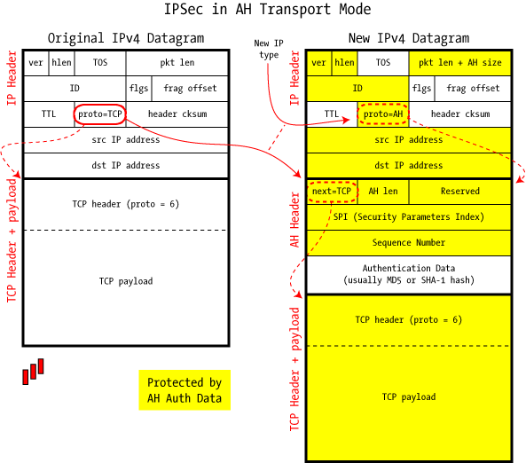
Transport Mode
http://www.unixwiz.net/images/IPSec-AH-Transport-Mode.gif

Slide 399
Tunnel Mode
Entire IP packet is encapsulated inside the tunnel
A new IP header is created for the tunnel traffic
Since original IP packet is encapsulated and encrypted, it is impossible to determine the nature of the original IP packet (Src and Dst IP, ports, protocols)

Slide 400
Tunnel Mode
Tunnel mode is typically used between gateways to provide VPN functionality across untrusted networks (e.g., Internet) for site-to-site communication or host-to-network (remote user access) communication
Supports NAT traversal because the entire original IP packet is encapsulated

Slide 401
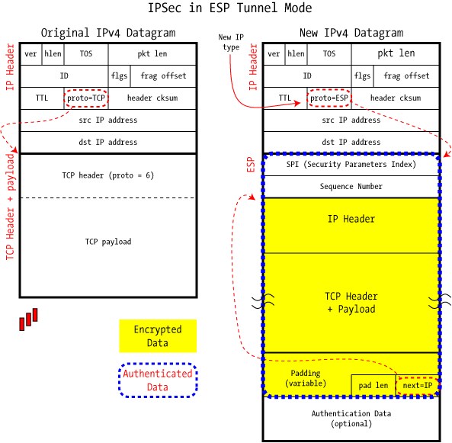
Tunnel Mode
http://www.unixwiz.net/images/IPSec-ESP-Tunnel-Mode.gif

Slide 402
Internet Key Exchange (IKE)
Used to build the security association of an IP communication flow
IPSec bulk data encryption typically uses a symmetric cryptographic algorithm to achieve reasonable performance (asymmetric algorithm is too slow for bulk data transfer)
Symmetric algorithm requires that both sides use the same key for encryption and decryption
This key must be securely created and maintained by both sides

Slide 403
Internet Key Exchange (IKE)
IKE provides a mechanism to create symmetric keys by both sides independently, without transmitting it
Uses slow, asymmetric algorithm to establish a symmetric key, then uses it for fast, symmetric algorithm for bulk data transfer
Provides the platform for both sides to authenticate and agree on encryption methods and integrity
Result of IKE negotiation is the Security Association

Slide 404
How Does IKE Work? Phase 1
IKE is negotiated in two phases:
The first phase of IKE begins with peer authentication
The authentication can either use a pre-shared key (PSK), signatures or public key encryption
Using Diffie-Hellman protocol, both sides can independently create the shared secret to be used in phase 2

Slide 405
How Does IKE Work? Phase 1
Outcome of IKE phase 1:
IKE SA, an agreement of shared keys (DH key) and methods for setting up IKE phase 2
At the end of phase 1, the two sides have authenticated each other and negotiated keying material, and have created an encrypted tunnel (control channel) to be used in phase 2 for setting up the ESP SA
Phase 1 can be negotiated in 2 modes: Main mode and Aggressive mode

Slide 406
How Does IKE Work? Phase 1
Video
https://www.khanacademy.org/computing/computer-science/cryptography/modern-crypt/v/diffie-hellman-key-exchange-part-2

Slide 407
Main Mode
In Main mode, the IKE phase 1 exchange consists of six packets:
Two packets for initiator sending and responder accepting SA proposal, which consists of authentication, encryption, key lifetime and perfect forward secrecy definition. Multiple proposals can be offered at the same time
Two packets for sending key materials (Diffie-Hellman) between initiator and responder
Two packets for secure authentication of peers using the DH key from step 2 to establish the IKE SA
Six packets results in slower setup time but peer authentication is performed in secured channel

Slide 408
Aggressive Mode
In Aggressive mode, the IKE phase 1 exchange consists of only three packets:
One packet for initiator to send SA proposal, DH key materials and authentication (unsecured) to responder
One packet for responder to reply with accepted SA proposal, DH key material, authentication (unsecured) to initiator and establishment of IKE SA
One packet from initiator to responder to complete establishment of IKE SA
This results in faster setup time but peer authentication (Peer ID) is passed in the clear text

Slide 409
How Does IKE Work? Phase 2
The second phase of IKE has one mode, called Quick mode
Starts with key and methods obtained from IKE SA, the basis for IPSec policy negotiation
Two sides negotiate the IPSec Security Association: encryption and integrity algorithm
The result: IPSec SA is used to create an IPSec tunnel to encrypt the actual data packets communicated between two sides (data channel)

Slide 410
SSL/TLS VPN

Slide 411
Overview
SSL VPN uses the Secure Socket Layer protocol to establish VPN functionality
Typically initiated from a portal via HTTPS protocol
Remote users log into an SSL VPN portal via HTTPS, and initiate a SSL VPN connection
Traffic between web browser and SSL VPN server is tunneled through the secure socket layer

Slide 412
Overview
Communication is a pure SSL connection, and actual traffic is tunnelled within SSL
SSL tunnelling nature makes it NAT- and firewall-friendly
Another advantage is the clientless feature.
No installation of a VPN application required on client computer
Allows the remote user to use any trusted computer to access the SSL VPN without software installation, increasing mobility

Slide 413
Types of SSL VPN: SSL VPN Portal
Provides the remote user access to different, predefined network resources/applications
Users are not allowed access to any network resources that are not defined in the portal
The SSL VPN portal gives greater control of user network access to improve security, and simplifies the user experience with the portal page

Slide 414
Types of SSL VPN: SSL VPN Tunnel
Building on the advantages of SSL protocol, an SSL VPN tunnel provides access to network resources via an installed client
A VPN tunnel can be established over SSL protocol, and provides access to the corporate network, similar to an IPSec client
The difference is that the SSL VPN client leverages SSL protocol to work around NAT and firewall issues, giving better connectivity to remote users

Slide 415
SSL VPN Vulnerabilities
SSL VPN is based on Secure Socket Layer protocol to provide encryption
It is only as secure as SSL protocol itself
Recent SSL vulnerabilities have rendered SSL protocol a highly vulnerable technology
Many companies, including financial institutions, have begun dropping SSL (all versions) in favour of TLS v1.2+

Slide 416
Point-to-Point Tunnelling Protocol (PPTP)

Slide 417
Overview
Point-to-Point Tunneling Protocol (PPTP) is an old VPN technology proposed by Microsoft and other companies
It is an extension to the Internet’s Point-to-Point protocol (PPP, layer 2 protocol)
It encapsulates PPP frames into IP datagrams for transmission over IP networks

Slide 418
Overview
PPTP is a standard VPN technology available on Microsoft Windows Remote Access Server
Uses a control channel for tunnel management and a data channel for the actual data tunneling

Slide 419
How Does PPTP Work?
PPTP uses TCP port 1723 to create and manage a tunnel with the peer
This is the control channel
PPTP then uses a modified version of the Generic Routing Encapsulation (GRE) to encapsulate PPP frames into the tunnel.
This is the data channel
With the PPP frame (layer 2 connectivity) encapsulated in GRE tunnel (layer 3 delivery mechanism), other protocols like IP and NetBEUI can be carried over the PPTP tunnel

Slide 420
PPTP Vulnerabilities
There are many security vulnerabilities associated with the PPTP protocol, associated with the authentication protocols used by PPP (the underlying protocol in PPTP)

Slide 421
PPTP Vulnerabilities
MS-CHAP-v1 is known to be broken. There are existing tools to extract the NT password hashes from a MS-CHAP-v1 traffic capture
MS-CHAP-v2 is susceptible to dictionary attacks on challenge response packets by existing tools

Slide 422
© 2017, Southern Alberta Institute of Technology. All rights reserved.
This publication and materials herein are protected by applicable intellectual property laws. Unauthorized reproduction and distribution of this publication in whole or part is prohibited.
For more information, contact:
Director, Centre for Instructional Technology and Development
Southern Alberta Institute of Technology
1301 16 Ave. N.W., Calgary, AB T2M 0L4

